Slide 1
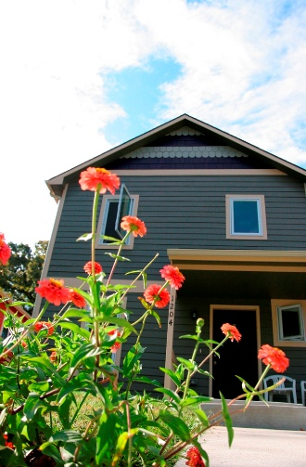
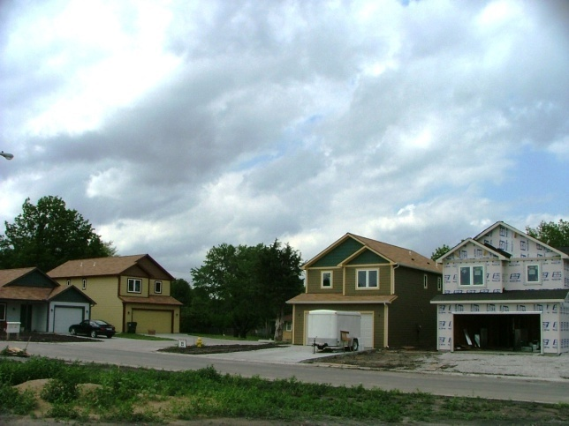
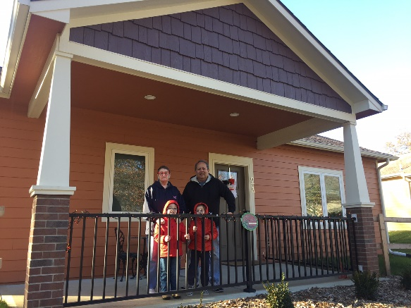
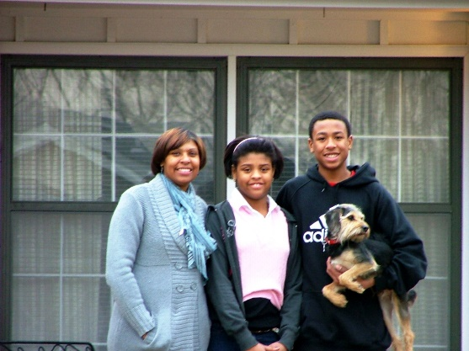
Creating A Permanently Affordable Housing Stock for the Lawrence Community

Slide 2
Tenants to Homeowners, Inc.
Community Housing Development Organization established in 1992 as 501(c)3.
Partnered with the city for their first Affordable Housing Project using HOME in 1996.
Put 278 families into their first homes with the HOOT Financing Program using silent deferred mortgages as 20% buy down.
2005 transitioned to Community Housing Trust Model and currently have 81 homes in trust.

Slide 3
Appreciating Market Challenges—Why we started a CLT and Now Addressing Gentrification
Gentrification
Low/Mod Income Families Displaced
Historically affordable neighborhoods changing EAST Lawrence
Property Tax Increases Pushing People Out
Investor Competition

Slide 4
Lawrence Price Growth
Although appreciation stopped in 2007 at 191,200, in 2010 the average sale’s price was still $162,900 and has gone up every year since. The 2017 average was $244,000, which is a $1676 payment at 5% IR that requires a $67,000 income with 0 debt. 2018’s average NEW sold price was $346,700

Slide 5
Lawrence Income Guidelines
LCHT serves families under 80% of the median income of Lawrence Average % of MFI since 2005 is 63% (34.9K for 1, 46K for 4)
LCHT 2018 M A XIMUM INCOME GU I D E L I N E S
1 $44,350
2 $50,650
3 $57,000
4 $63,300
5 $68,400
6 $73,450
Largest Employers in DG County | # of Employees
Kansas University (landscaping, dining, housekeeping, administrative) | 9,881
Lawrence Public Schools (teacher starts at | 1,800
City of Lawrence | 1,455
Lawrence Memorial Hospital | 1,322
Berry Plastics | 739
Hallmark Cards | 525
Baker University | 496

Slide 6
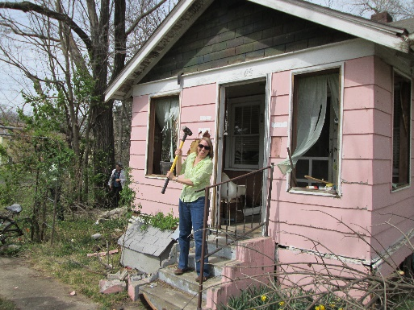
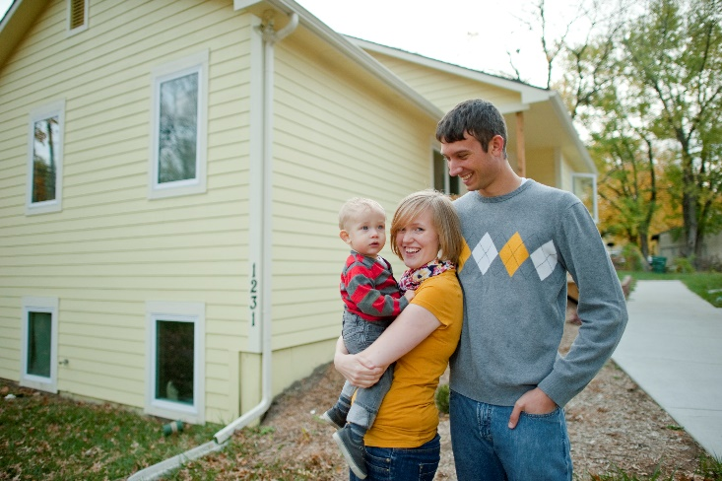
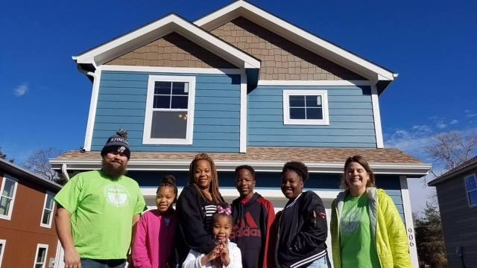
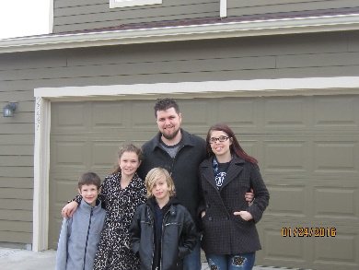
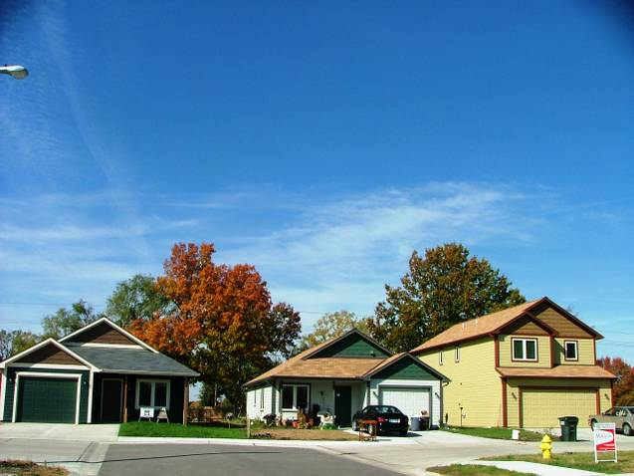
LCHT HOMES
Partnership Project 3 homes
Laura Ave. 5 homes
Prairie Wind 18 homes

Slide 7
Community Land Trust Definition
A community land trust (CLT) is a nonprofit corporation that develops and stewards affordable housing, community gardens, civic buildings, commercial spaces and other community assets on behalf of a community. “CLTs” balance the needs of individuals to access land and maintain security of tenure with a community’s need to maintain affordability, economic diversity and local access to essential services.

Slide 8
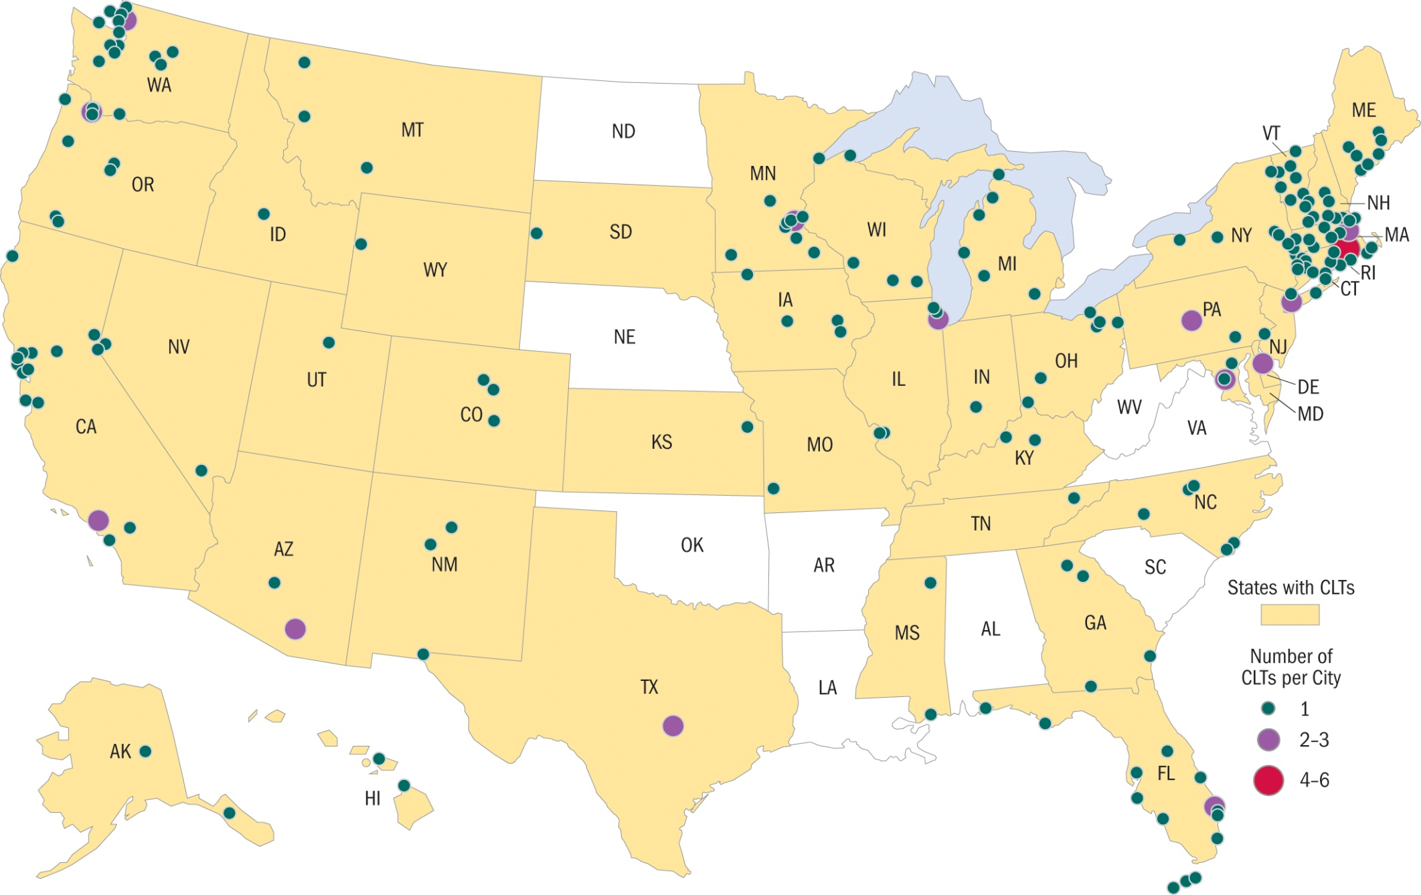
CLTs Across the Country—Few in the Midwest

Slide 9
The Problem with Subsidy Recapture
$
Now the City has $10,000 to reinvest.
Unfortunately…
$150,000
$100,000
They need $50,000 to make the same house, now $150,000, affordable to a family at the same income level.
Time
Understanding Subsidy Retention Subsidy Recapture

Slide 10
What is a Lawrence Community Housing Trust Home?
In exchange for $30-50,000
off the initial price:
-homebuyer has title to the improvements and has the right to use the land like any other homeowner
-LCHT has title to the land -99 year ground lease is the legal instrument that governs this relationship
-Homebuyer pays nominal lease fee $30/mo.
-Homebuyer agrees to sell at a restricted resale price based on a formula to an eligible buyer

Slide 11
LCHT’s Resale Formula:
Initial sales price to buyer + 25% of overall appreciation(final market appraisal value-initial market appraisal value) = Resale Price EQUITY 1—This means a family that purchases a housing trust home gets all of the money they put down and paid on their first mortgage
EQUITY 2—Plus 25% of the overall market appreciation of their home while they lived there
They also get to live in a home that is valued $50,000
more than they could afford on their own. This often means an extra bedroom, less maintenance, and energy efficiency.

Slide 12
How do we explain LCHT ownership?
Long term ground lease different than month to month lease of home and land
You own house and can paint it pink
Not much you can do to hurt value of the land…few restrictions
We care about passing affordability on so we limit what you can sell it for. If you can buy what you need on the open market without restrictions you don’t need us.

Slide 13
Why Buy with LCHT?
Living in a house worth 42,000 more than you are paying in mortgage payment—In Lawrence this means an extra bedroom or a garage new vs. 60 years old Energy Star= $150 monthly savings in utilities
No PMI, save 3000 in closing costs,
down payment under 2500, lower taxes
Advocacy throughout—tool lending library maintenance help

Slide 14
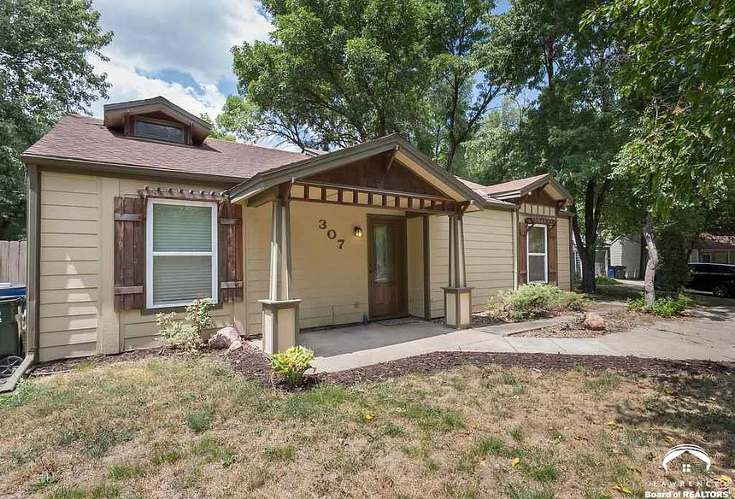
Market comparison in Lawrence
2 bdrm, 1 bath
Built in 1978
760 square feet
no garage
Price $99,900

Slide 15
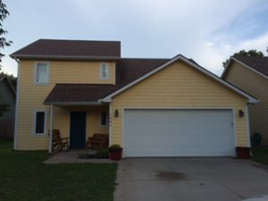
Comparable Housing Trust Home:
1647 Bullene Ave.
3 BR, 2 Bath
1,474 ft²
2 car garage
Energy Star Rated All Electric
Built by TTH in 2007
Close to Burroughs Creek Trail
LCHT Price: $100,000
$775/mo. including taxes, insurance and lease fee at 4.75% IR

Slide 16
Benefits of LCHT we Discovered in Depreciating/Stagnant Market
In Lawrence 2007-2013 Prices dropped and then came back, so those who bought and sold within this time did not have market appreciation. There were 9 resales that still happened in this time.
Depreciation was not subtracted from the resale price and no one had enough depreciation to dip into their equity. They all got to take whatever down payment and equity they built by paying down principal.
Some had also made capital improvements that allowed them to earn equity.
Maintenance Fund was used more during this time. Several used to pay mortgage if there was a layoff or income change during the recession.
No foreclosures in a market that was at 4%.
We lost some “value” in our subsidy, but since then have earned it back and more—so like the stock market play the long game.
Condo values decreased more than SF, so one of those was additionally subsidized.
Resale maintenance harder when people are forced to downsize, so maint account critical and TTH kept fund.
Lender partner relationships critical—3 examples where families “downsized”
More attendance at maintenance workshops! Free chili and we had 35 people.

Slide 17
Things to Think About As We Grow…
Administrative Capacity for Resales—We have had 40 LCHT Resales although we have also done 7 HOOT Resales. Need to be sure you have the time and procedure worked out as they begin at a steady pace when you have 40 houses in trust. Focus is to establish a strong waiting list and lots of prospective buyers. Maintenance account helps and clear line of what is expected to be fixed.
Maintenance of Housing Stock—Of course this is the homeowners’ responsibility, but what if they defer maintenance? We provide an emergency maintenance account, emergency loan fund and quarterly maintenance newsletters and workshops. We have a tool lending library, full time maintenance staff and are there to answer any question a homebuyer may have. Our new construction comes with a one year warranty. As housing ages, gets more difficult. Check in with owners.
Property Taxes—We appealed the way Douglas County assesses the LCHT properties and after a 2 year legal process with KS state COTA they agreed that the restrictions on the resale price must be considered when determining value. Huge issue for some homebuyers (1814 Haskell assessment went from 167,000 to 89,000). Deal in 2009 to use resale formula. Argue that TTH has added 3,232,000 in increased property value with infill development. CLT must watch county. In 2012 we discovered they weren’t calculating correctly so now we have a sheet to fill out every year, but more admin.

Slide 18
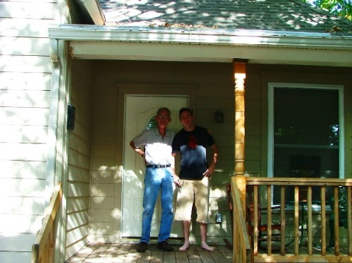
C of CLT (CHT) in Lawrence
LCHT Homeowners represented on BOD
Advocacy for fair tax evaluation
Maintenance Workshops, Referrals and Assessments
Tool Lending Library
Resale help (seller does not pay commission)
Maintenance Savings Account and Emergency Loans Refinance Help
= NO FORECLOSURES

Slide 19
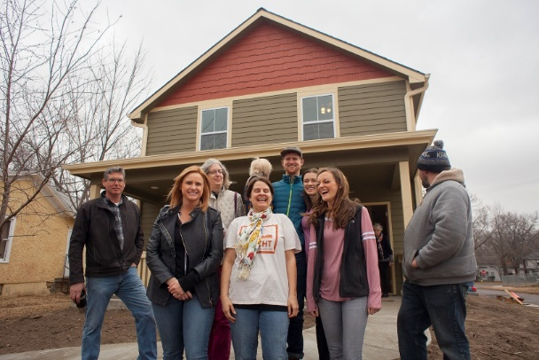
We just put our 81st home in trust. (56 new construction built by TTH, 7 acquisition rehabs by TTH, 6 HOOT recaptures, and 12 buyer-initiated acquisitions).
We have a majority of single family and townhomes where TTH retains title to the land and provides the buyer with a long term ground lease. 8 properties are condo/townhome units where there are covenant restrictions instead of a ground lease.
The average sale price to the buyer of these 81 examples is $108,000 in a market where the ave. price of a home is $244,000. Most of these homes are under 10 years old and energy efficient. The ave. appraisal value of these homes is $153,000 with an ave. subsidy of $45,000.
Since 2005 there have been 39 successful resales. 85% used their equity to buy in the unrestricted market. LCHT -provides the efficient use of shrinking affordable housing dollars to create the biggest impact for the community.
LCHT in 2018
81

Slide 20
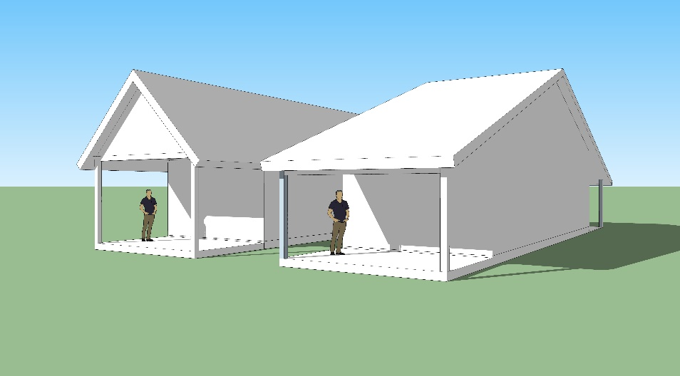
LCHT Into the Future
We currently have 5 homeowner houses in progress including 4 small 650 Sq. ft homes. We are working with the city on an affordable density bonus ordinance.
TTH has 70 affordable rentals that provide the majority of our operating costs. This includes our newest 14 unit Cedarwood Senior Cottages, which has smart tech for aging in place assistance. This also includes 20 units of LIHTC property for people with physical disabilities. We are building 3 currently for homeless families and are working with KU Endowment to bring 11 more units online for victims of domestic violence, including a transitional house that can also serve girls aging out of foster care and victims of human trafficking.

Slide 21
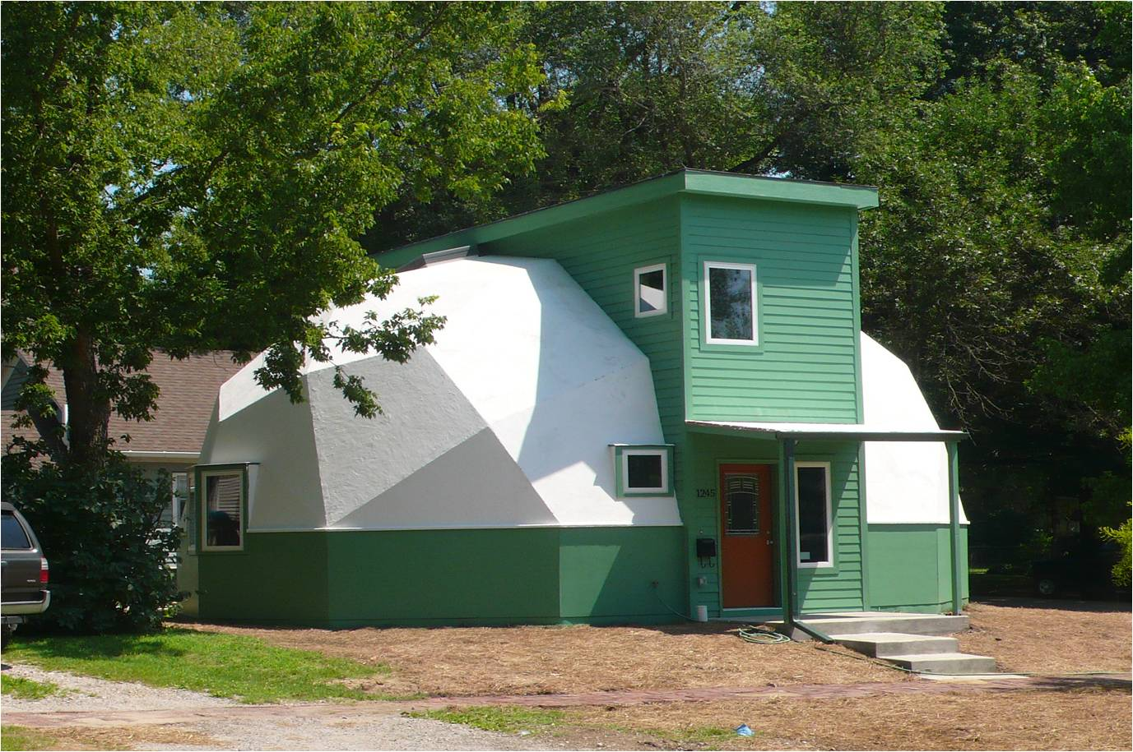
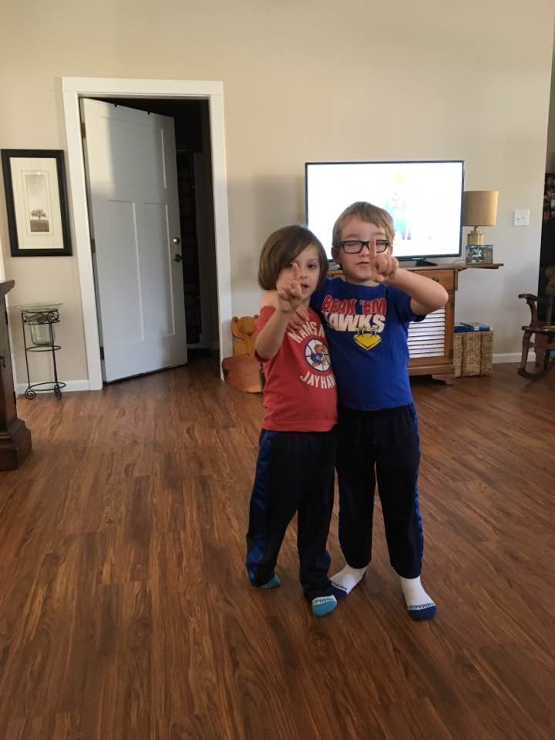
Thank You.
Creating Permanently Affordable Housing for the Lawrence Community!
Rebecca Buford
Executive Director
785-760-2058
Tenants to Homeowners, Inc.
The Lawrence Community Housing Trust
rbufordefird@yahoo.com
www.tenants-to-homeowners.org
ROCK CHALK JAYHAWK, GO KU!

