Slide 1

Housing Affordability Problems in the
Geary, Pottawatomie, and Riley
County Area
Kirk McClure, Professor of Urban Planning
mcclure@ku.edu
Notes:
Housing affordability is a matter of considerable discussion
Designing policies to resolve housing affordability problems requires diagnosis
Questions:
Are affordability problems due to:
Supply problems:
Shortage of units?
Pricing of the units?
Demand issues:
Weak demand, too few households?
Weak demand, too little income?
Correct diagnosis can help policy makers adopt the right solutions.
Incorrect diagnosis can lead to wasted resources and can actually worsen problems
Commonplace in the US to build units where additional units are not needed
Often, we need policies to help consumers enter the market and/or rehab units
Source: American Community Survey 2017

Slide 2
Housing Affordability Problem
• No single definition of affordability problems
• Generally accepted definition is paying more than 30% of income housing
• Usually restricted to low-income households
Kirk McClure, Professor of Urban Planning
mcclure@ku.edu
Notes:
Start with defining housing affordability problem
No single definition exists
Generally accepted is the allocation of income
> 30% High housing cost burden
< 30% Affordable
US Owners Average 18.2% (23% with mortgage)
Renters Average 30.3% (thus one-half burdened)
Incomplete because all housing is affordable to someone
Virtually no housing is affordable to all
Usually restrict the definition to households of low income
Middle and upper income households usually have options
If they adopt approach of spending > 30%
it is a conscious decision
Alternative definition: Residual income, less well suited to Kansas

Slide 3
Kirk McClure, Professor of Urban Planning
mcclure@ku.edu
Notes:
Build a few tables Look at Households paying more than 30%
First table is owner-occupants (renters later)
Left side all owner-occupants Right just low-income
For each List total households, >30% and percentage
List three-counties as a whole and the 3 counties
individually
Also list Kansas for comparison

Slide 4

Kirk McClure, Professor of Urban Planning
mcclure@ku.edu
Notes:
Among all owner-occupants in Kansas
18% suffer a high-housing cost hardship
By national standards, this is about normal
US is 18.2, less than a percentage point of Kansas

Slide 5
Kirk McClure, Professor of Urban Planning
mcclure@ku.edu
Notes:
Three-county area
Little bit worse at 18.9%
A little above Kansas as a whole
The variation within the three-county areas is considerable
Riley is lowest at 16.7% but Pottawatomie close at 17.2%
Geary is the highest at 26.2%

Slide 6
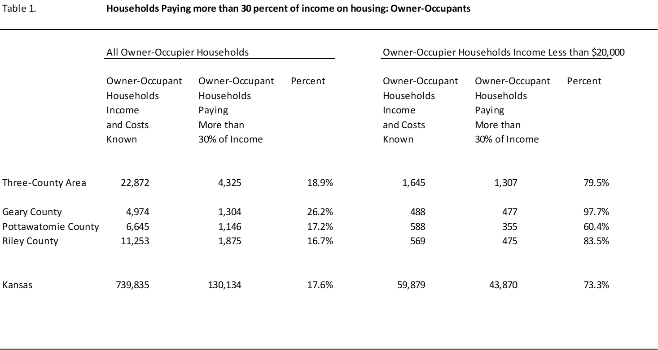

Kirk McClure, Professor of Urban Planning
mcclure@ku.edu
Notes:
Picture for low-income households gives some insights to the problem
If the problem is insufficient incomes, would expect higher
incidence of high housing cost hardship among the poor
(Remembers that this is not definitive evidence of low incomes driving
the problem. It could still be high prices.)
We find that the incidence of high housing cost hardship is higher
73% of the low-income suffer a high housing cost hardship in Kansas

Slide 7
Kirk McClure, Professor of Urban Planning
mcclure@ku.edu
Notes:
79% of low-income in the three=county suffer high housing cost hardship
Range across the counties is instructive
Again Geary worst at 98%
Pottawatome least worst at 60%
Riley in the middle at 84%
Note: Definition of low-income, many exist
HUD often uses 80% of AMI, too high for most purposes
Here use $20,000, reflects the poverty level,
8% of owners but 26% of renters
Problem could be the price structure of the housing rather than
the presence of low-income households
We will examine that issue in a minute

Slide 8
Kirk McClure, Professor of Urban Planning
mcclure@ku.edu
Notes:
Table 2 repeats the analysis for renter households
Find Kansas 44% of all renters pay > 30% (US is 51%)
Much higher than the 18% among owner-occupants
Three Counties Higher at 52%
Range is wide Pottawatomie 36% to Riley at 55%
Among renters with incomes below $20,000
Kansas 88% Three counties higher at 94%
All three counties are high at 91% or more
Conclude: Problems are not unusually high among owners at 18%
But high among poor, both owners and especially renters

Slide 9
Housing Affordability Problem
• In a well functioning housing market,
prices rise at the same rate as household
income
Kirk McClure, Professor of Urban Planning
mcclure@ku.edu
Notes:
Prior tables were a snapshot of the matchup of households and there spending on housing
Look now at the incomes and pricing of housing that drive this snapshot
Examine trends in growth in income and prices
In a well-balanced market, we should see prices rise commensurate with growth in incomes
A definition of a bubble is prices rising faster that the foundational measure of demand which is the income of the population.
We had such an experience 2000 to 2007 among owners
Bubble burst with the crash of the mortgage market,
recession 2008-2009
Recovery 2010 to the present

Slide 10
Kirk McClure, Professor of Urban Planning
mcclure@ku.edu
Notes:
Again a pair of tables, one for owner-occupants and one for renters
Look at Median values 2010 and 2017 (recovery period)
Median incomes Same period
Ratio of value-to-income Should be relatively constant
US for comparison 2017 median value 193,500
median income 73252
ratio 2.6 DOWN from 2.9 in 2010
First notices that Kansas is affordable by national standards
Median value 61% of the US median value
Turn to trends in prices and incomes

Slide 11
Kirk McClure, Professor of Urban Planning
mcclure@ku.edu
Notes:
Kansas house prices rose 13.5% which is faster than inflation of 12.1%

Slide 12
Kirk McClure, Professor of Urban Planning
mcclure@ku.edu
Notes:
Incomes rose 13.7% percent
Two takeaways Incomes up faster than inflations
means a higher standard of living
Values of homes keeping pace with
growth of incomes
Good
Where values rise faster than incomes
good for net worth but bad for affordability

Slide 13
Kirk McClure, Professor of Urban Planning
mcclure@ku.edu
Notes:
Kansas Ratios 2.0 both time periods
Sign of a well balanced market
Three counties Much variation: Home values
Values all rising faster than inflation 7 to 10 percentage points
Incomes rising as well but not evenly
Geary: housing prices faster than income
Thus rising ratio
Pottawatomie both values and income up evenly
Riley Incomes faster than prices

Slide 14
Kirk McClure, Professor of Urban Planning
mcclure@ku.edu
Notes:
Renters do not have the net worth issue, renters need to see rents as a percent of income stable or falling.
Kansas Relatively flat annual rents to incomes 28% over time
US ratio was 32% both 2010 and 2017, thus Kansas affordable
3 counties Good signs
Riley incomes rising faster than rents
Thus falling ratio
Bad signs Geary and Pottawatomie
Rents rising faster than incomes
Thus rising ratio
Conclude: An affordable market overall but parts are becoming less so

Slide 15
Housing Affordability Problem
• In a well functioning housing market,
housing stock growth closely matches
the rate of household formation
Kirk McClure, Professor of Urban Planning
mcclure@ku.edu
Notes:
Incomes and prices are not the only drivers of pricing in housing markets
Also concerned with basic growth in demand in terms of households
and growth of supply in terms of housing units
In a well-function housing market, the housing stock growth closely matches the rate of household formation
thus, Growth in stock follows (not leads) growth in population

Slide 16
Kirk McClure, Professor of Urban Planning
mcclure@ku.edu
Notes:
Table five looks at demand (household growth) and supply (housing units)
Note Mixes all units here (not separate by renters and owners)

Slide 17
Kirk McClure, Professor of Urban Planning
mcclure@ku.edu
Notes:
Kansas Supply growth has been faster than demand growth
(3.0% hh to 1.8% units)
Not a good sign
Does not add to tax base
Income drives values
Not the presence of buildings
Coming off the bubble which boosted supply too fast and too greatly

Slide 18
Kirk McClure, Professor of Urban Planning
mcclure@ku.edu
Notes:
Three counties Rapid growth in households up 9.4%
All three counties are up but
Driven by growth in Riley (7.4%) and Geary Counties (13.6%)

Slide 19
Kirk McClure, Professor of Urban Planning
mcclure@ku.edu
Notes:
Kansas Housing stock up faster, too fast, outpacing demand
In a well functioning market
Stock should grow by the same pace as the growth in households
Should maintain vacancy rates at 2% owner and 5% renter
Some dispute on the 5% level for renters, could be higher
Problem now is “other vacant” probate, foreclosure, remodels
Was a small issue 1.5% in the 1990s now a significant problem 3.5%

Slide 20
Kirk McClure, Professor of Urban Planning
mcclure@ku.edu
Notes:
Three counties Followed the pattern with supply outpacing demand
Individual variation
Geary household formation faster than stock growth
but more than adequate units
Pottawatomie Pretty balanced
Riley Rapid overbuilding HH up 7.4% and Units up 11.2%

Slide 21
Kirk McClure, Professor of Urban Planning
mcclure@ku.edu
Notes:
Kansas added 16,000 surplus homes or 1% of the stock
Not helpful
Pulls finite value, dictated by the incomes of the households,
away from existing older homes

Slide 22
Kirk McClure, Professor of Urban Planning
mcclure@ku.edu
Notes:
Three counties
Same added 1,500 surplus homes or 3% of the stock
Variation by county
Small in Geary and Pottawatome counties 1%
Riley up 1,848 households
Built 3,041
Surplus of 1,200 housing units
Not good for a market
Hurts values of existing homes
Discourages maintenance
Not a big issues now as values rising
4% of stock
1 in every 25 homes/apartments

Slide 23
Housing Affordability Problem
• In a well functioning housing market,
the counts of units in each price range should
closely match the number of households in
the corresponding income category
Kirk McClure, Professor of Urban Planning
mcclure@ku.edu
Notes:
Mentioned that we would look at the price profiles to see if they match income
In a well functioning housing market
counts of units in each price range should closely match
counts of housing in corresponding income category

Slide 24
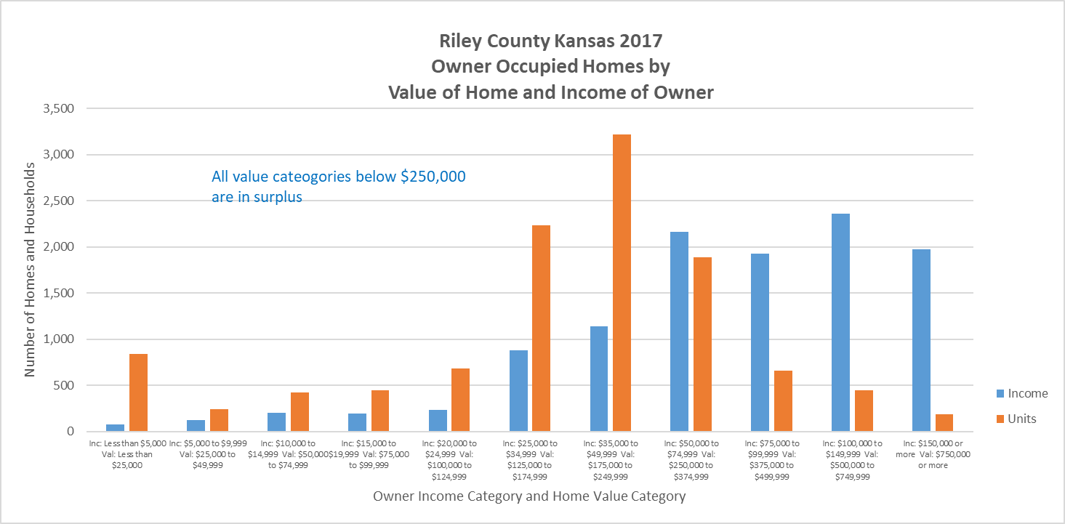
Kirk McClure, Professor of Urban Planning
mcclure@ku.edu
Notes:
Look at Riley county
Not greatly different across Flint Hills or Kansas
Owners
Blue bars counts of households by income range
Red bars counts of housing units by price
Units (red) is same or higher than households (blue) market is balance
Units (red) is greater than households (blue) submarket is in surplus
Units (red) is shorter than households (blue) submarket is in scarcity
Affordability of Riley count is seen in the fact that every category
below $250,000 has more units than households
Markets above $250,000 some shortage, but some upper income
choose to consume lower price home as a matter of choice
Conclude: Problems is not too few units or prices too high, problems are income

Slide 25
Kirk McClure, Professor of Urban Planning
mcclure@ku.edu
Notes:
Riley Renters
Very different story
Surplus in markets rents $626 per month to $1,250 per month
Shortage in markets rents below $500
Note: No one can profitably produce units at $300
Deep subsidy needed
Current production program is LIHTC
Produces units at $800 to $1,100
Submarket with a surplus
Housing Choice Vouchers work

Slide 26
Housing Affordability in the Three-County Area
• 1 in 6 owner-occupants and 1 in 2 renters suffer high housing cost hardship
70 to 90 of households with income below $20,000
• CPI up 12%, incomes up faster at 14 to 18%, rents up 20% and values up 25%
• Stock growth (8%) slightly outpacing growth in households (5%)
• Individual submarkets, mostly in surplus among owners, shortage rentals < $500
• The area has enough units, prices are generally good, but too many households have insufficient income to enter the housing market without hardship
Kirk McClure, Professor of Urban Planning
mcclure@ku.edu
Notes:
Conclude
1 in 6 owners and 1 in 2 rents suffer high housing cost but 70% to 90% of the poor
CPI up 12%, incomes rising faster, thus standard of living is up
But rents up faster at 20% and values up 25%
Stock growth is outpacing household formation
It is not yet a bubble to be feared, but it is heading in that direction
Most submarkets are in surplus, only poor renters suffer from a shortage
The three counties have enough units, prices are generally good
Too many households have insufficient income to enter the market without hardship
Incomes not supply or pricing is the driver of affordability problems

Slide 27
Thank you
Kirk McClure, Professor of Urban Planning
mcclure@ku.edu
Notes:
Thank you
Questions

