Slide 1
“Submitting an Academic Innovation Fund (AIF) Proposal”
December 5, 2023

Slide 2
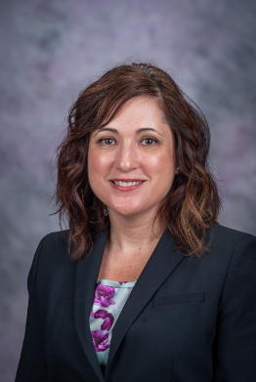
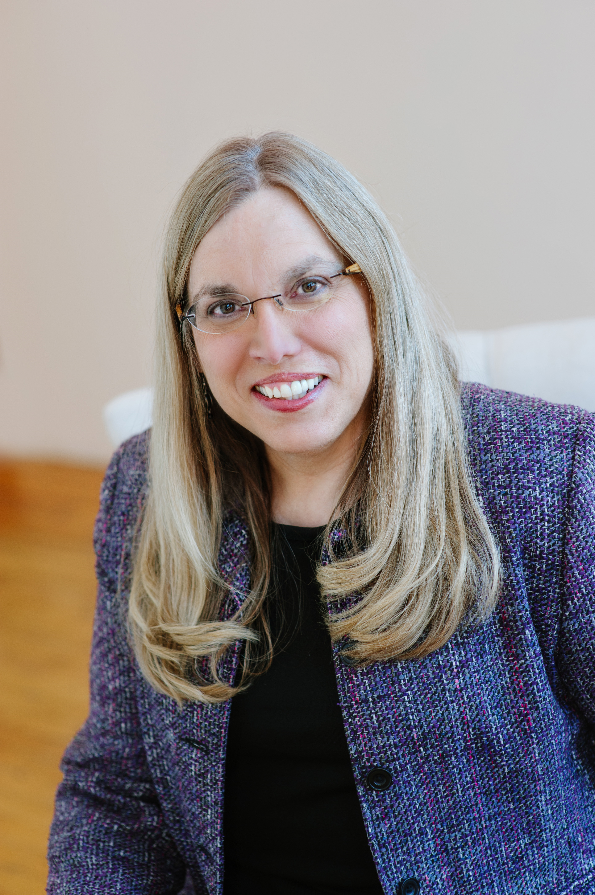
AIF Co-Chairs
Tanya Gonzalez Karen Pedersen
Professor of English and Interim Dean of Global Campus
Associate Provost for Institutional
Effectiveness

Slide 3
Thank You - AIF Review Team
Hansin Bilgili, Assistant Professor, Department of Management, College of Business Administration
Scott Barton, Assistant Professor, Department of Interior Architecture & Industrial Design, College of Architecture, Planning & Design
Jennifer Bormann, Professor, Department of Animal Sciences and Industry, College of Agriculture
Don Kurtz, Professor and Department Head, Department of Sociology, Anthropology, and Social Work, College of Arts and Sciences
Mindy Markham, Professor and Department Head, Department of Applied Human Sciences, College of Health and Human Sciences
Michael Oetken, Assistant Professor, Department of Integrated Studies, College of Technology and Aviation
Heather Woods, Associate Professor and Interim Director, A.Q. Miller School of Media and Communications, College of Arts and Sciences

Slide 4
Direction for Today’s Session
Vision 5. Q & A
2. Process 6. Additional
Resources
3. Market Research
4. Timeline

Slide 5
1. Vision

Slide 6
Vision
Meet regional, national or international learner or workplace needs of the future
Drive bold curricular innovation and academic excellence
Align with Next-Gen K-State strategic plan
Support long-term financial viability

Slide 7
2. Process

Slide 8
Process
Ideate and consider new curricular opportunities (microcredentials – credit and noncredit, certificates, minors or degree programs at all levels) that realize the AIF vision
Garner support - discuss proposal idea(s) with others (e.g., colleagues, department chair, dean)
Contact the Market Intelligence & Analysis team for assistance
Review the application carefully and draft responses (responses must adhere to the specified word count for each question)
Ensure required signatures are in place prior to submission
Submit proposal using the fillable .pdf by the deadline – late proposals will not be considered

Slide 9
3. Market Research

Slide 10
Market Research
Has a market analysis been performed by K-State’s Market Intelligence and Analysis team? global.k-state.edu/market-research/

Slide 11
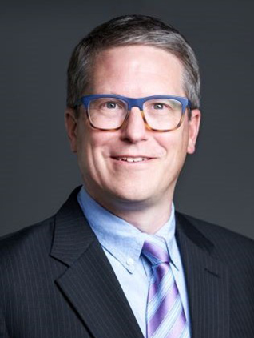
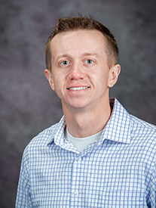
Market Intelligence and Analysis Team marketanalysis@ksu.edu
Jonathan Barber
Reed Bellamy
Anna Salas

Slide 12
4. Timeline

Slide 13
Timeline
Now: Contact the Market Intelligence & Analysis team
March 1, 2024: Completed proposals, with department head and dean signatures, are due by midnight central time
March 4 – 25: Proposal under review by the AIF Review Team
Week of March 25: Review team provides recommendations to provost and notifications go out to PI’s, department heads, and deans
Week of April 1: Funded proposals are announced in K-State Today

Slide 14
5. Q & A

Slide 15
Q & A – Starter Questions
What if a department wants to submit more than one proposal?
Is it acceptable for a faculty/staff member to be involved with more than one proposal?
Should proposals be framed within a specific budget range?
Can we submit our own market research?
How will proposals be evaluated?
What if a member of the review team wants to submit a proposal?

Slide 16
6. Additional Resources

Slide 17
Additional Resources
Send questions to:
academicinnovation@ksu.edu
Updates posted to:
https://www.k-state.edu/provost/academic-innovation/index.html
Consider other funding sources:
KSU Foundation – Rebecca Lester – rebeccal@ksufoundation.org

