Slide 1
Reframing Failure
Tara Coleman and Greg Eiselein

Slide 2
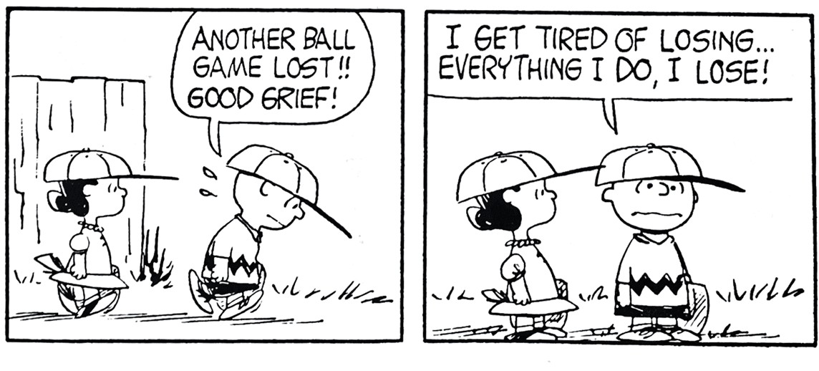

Slide 3
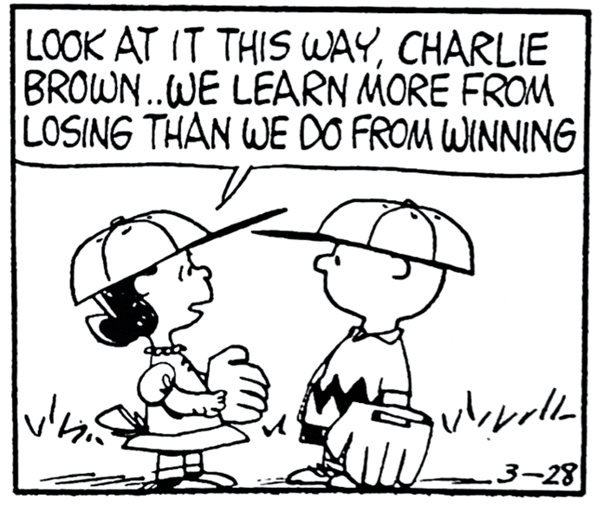

Slide 4
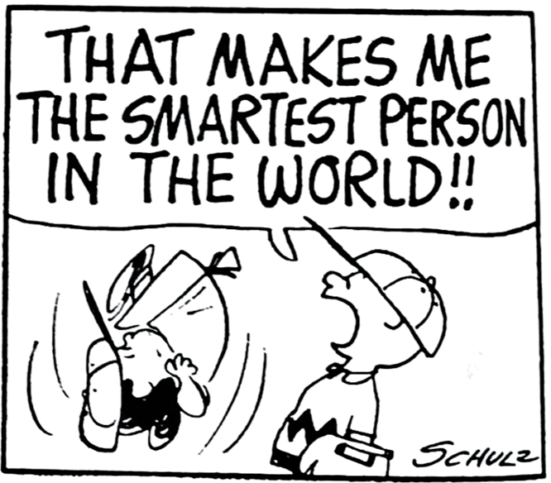

Slide 5
LISTEN AND MEET THEM WHERE THEY ARE
MAKE IT LOW STAKES
MODEL
PROVIDE FEEDBACK
REFRAME

