Slide 1
Going Global with Less Talk and More Action
Lotta Larson
Department of Curriculum & Instruction
College of Education

Slide 2
Orbis Sensualium Pictus (The World Explained in Pictures) by Comenius (1658)

Slide 3
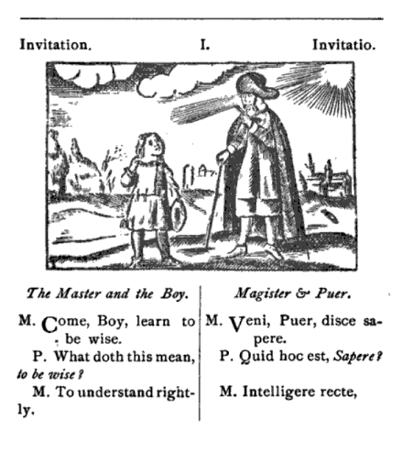
The Invitation (Invitatio)
Teacher: Come here boy! Learn wisdom. Pupil: What does that mean? T: To understand rightly, to do rightly, to pronounce rightly, all that is necessary. P: And who is going to teach me that? T: I am, with the help of God.

Slide 4
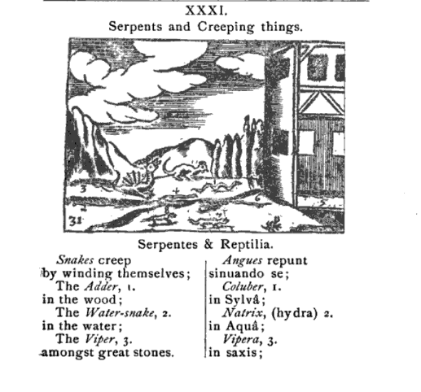
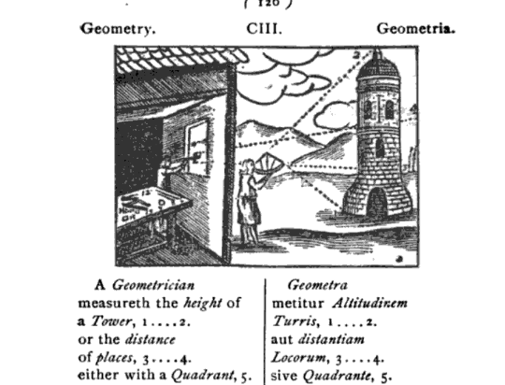
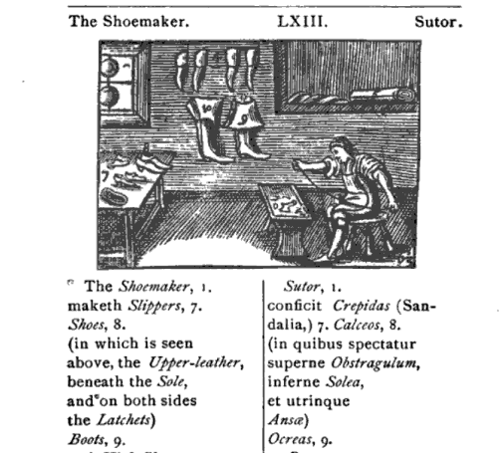

Slide 5
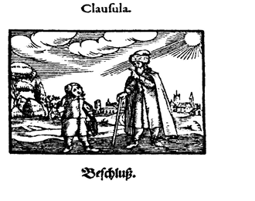
The Conclusion (Clausula)
Teacher: Now you’ve seen, in short, all the conceivable …
Go on like this and read diligently other good books, so that you will become educated, wise, and pious.

Slide 6
The teacher role is changing…

Slide 7
Challenges in Teacher Preparation
Prepare K-12 students for jobs that don’t exist
Provide culturally and linguistically diverse experiences
Integrate technology and digital tools
Make the classroom dynamic
Create authentic opportunities to collaborate, create, and communicate
Prepare global-ready students
Less talk and more action

Slide 8
Going Global
Online teaching and learning experiences with K-12 students, university students, and cooperating teachers in other countries
Partnership with K-12 schools and Linnaeus University in Växjö, Sweden

Slide 10
Teaching English to Swedish 5th Graders

Slide 11
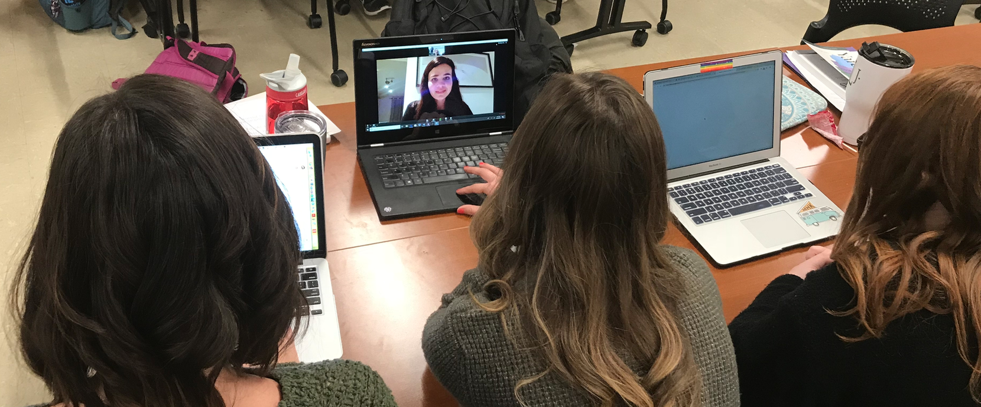
Collaborations with Swedish University Students (future English Teachers)

Slide 12
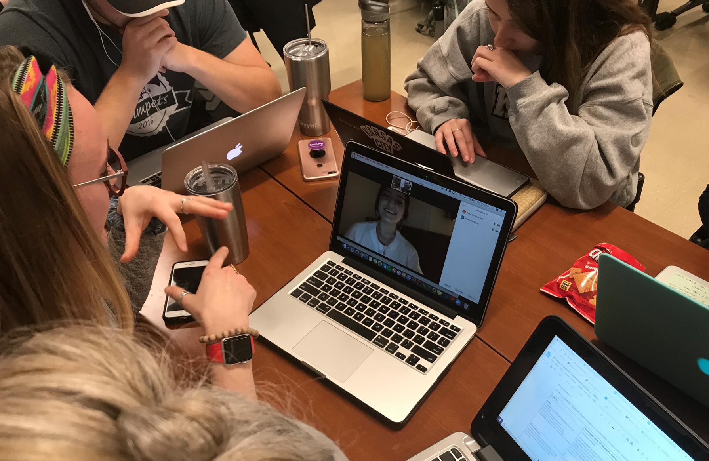
Collaborations with Swedish University Students (future English Teachers)

Slide 13
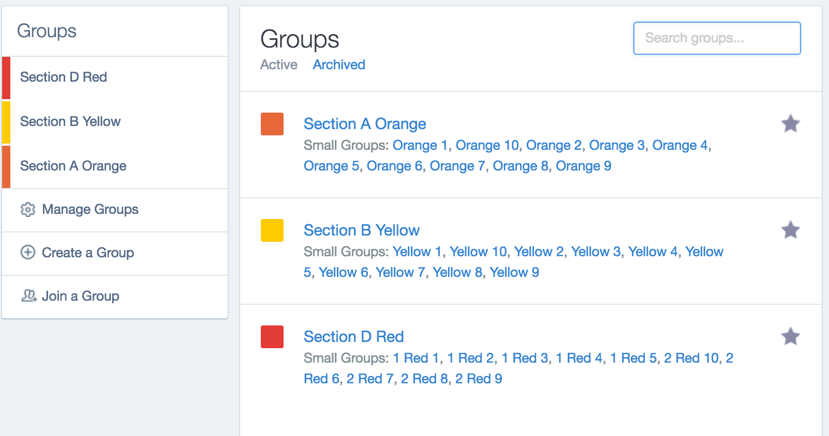
Online Literature Discussions with Swedish Ninth Graders
Edmodo Blogs

Slide 14
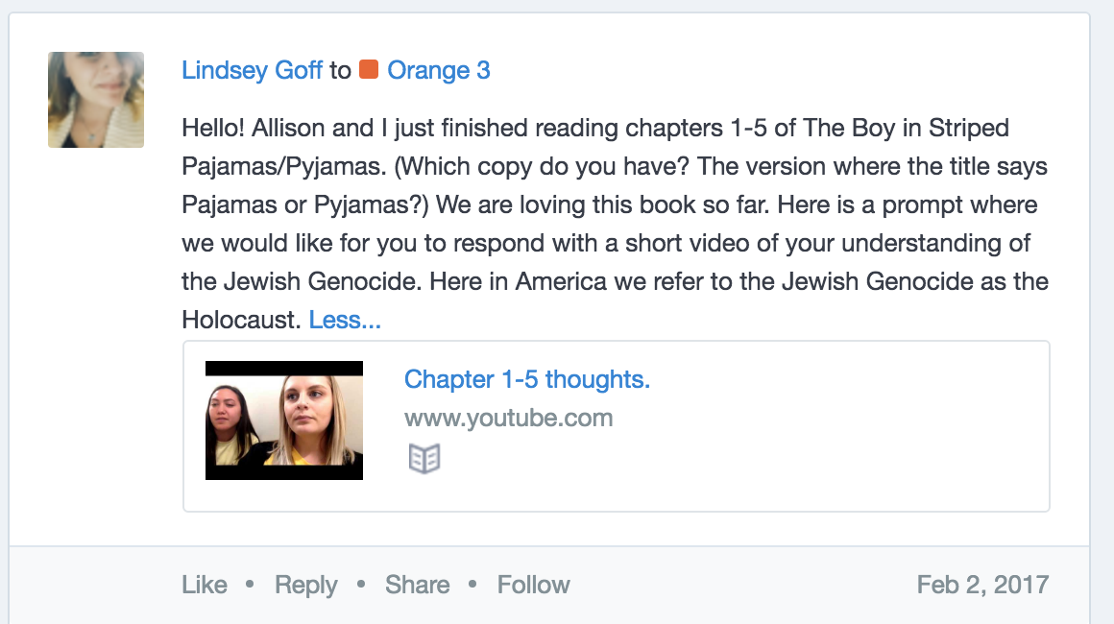

Slide 15
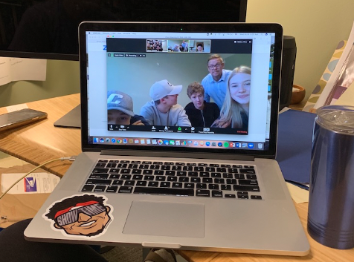
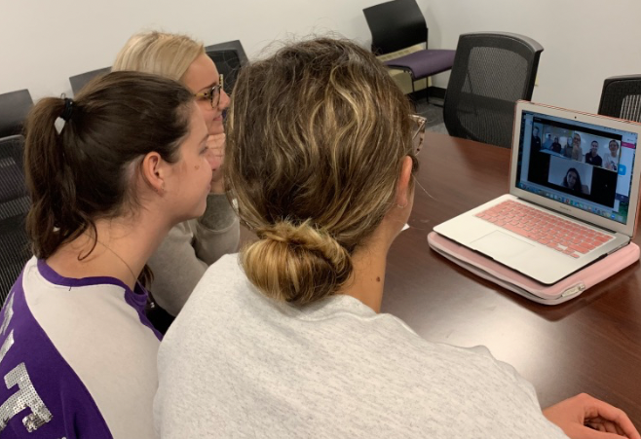
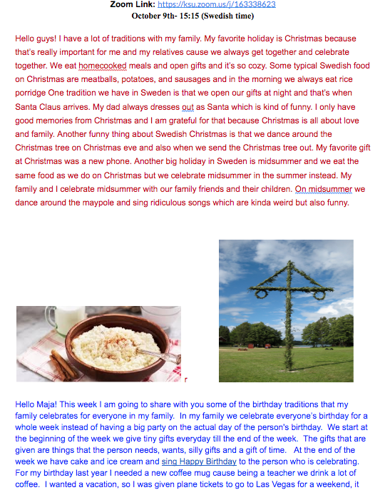
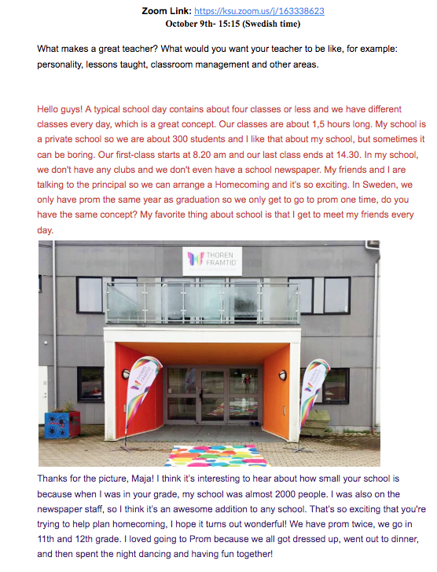
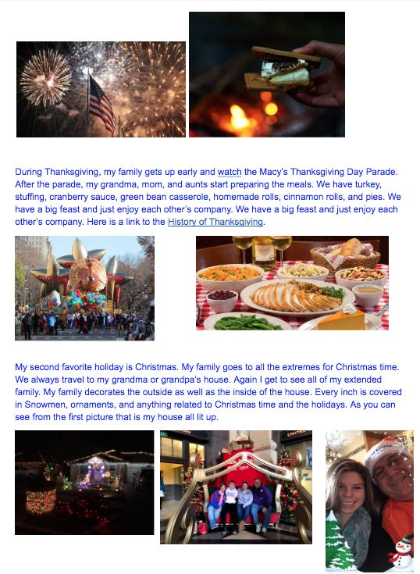

Slide 16
What do they learn?
Swedish K-12 Students
Gain experience communicating in English
Feel more prepared to work with in a global community

Slide 17
What do they learn?
Swedish University Students
Communicating in English
Collaborating with K-State future teachers (lesson design, assessment, digital communication tools)

Slide 18
What do they learn?
K-State College of Education Students
Gain global competence
Work with diverse students and colleagues
Teach in online environments
Use digital tools

Slide 19
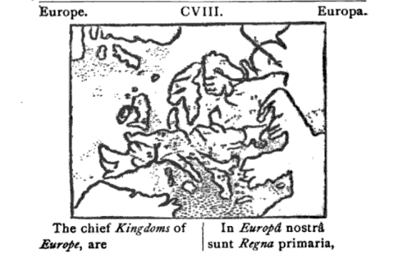
Demand for Global Competence

Slide 20
Global-ready students need global-ready teachers

