Slide 1
Persisting Through Frustration
Jennifer Anthony
Tim Taylor Department of Chemical Engineering

Slide 2
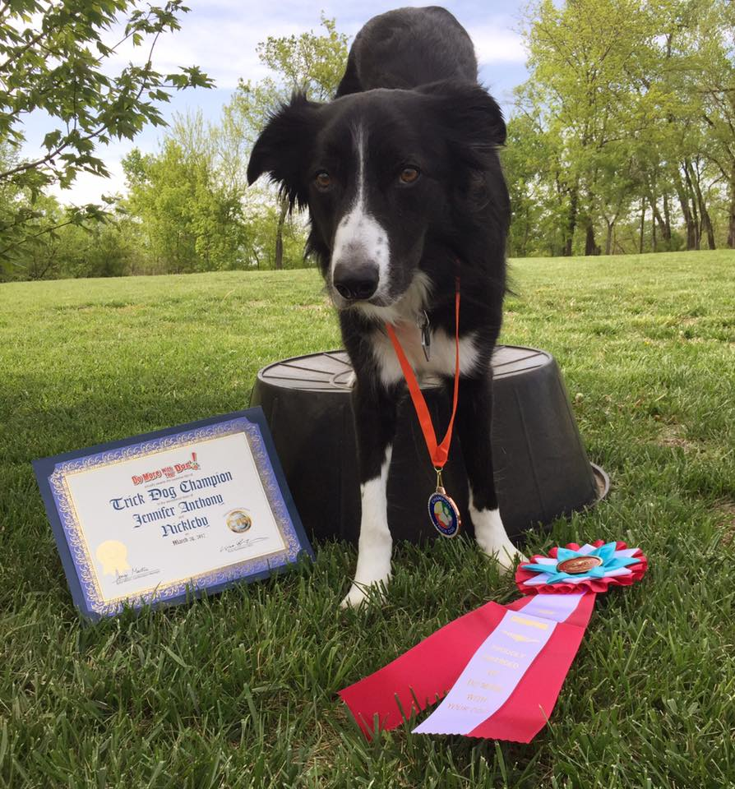
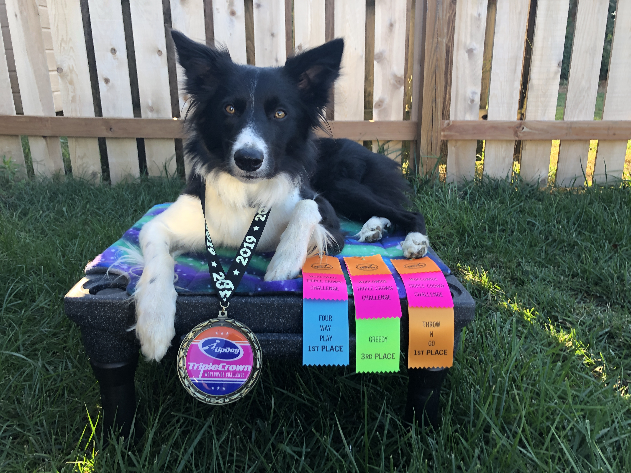
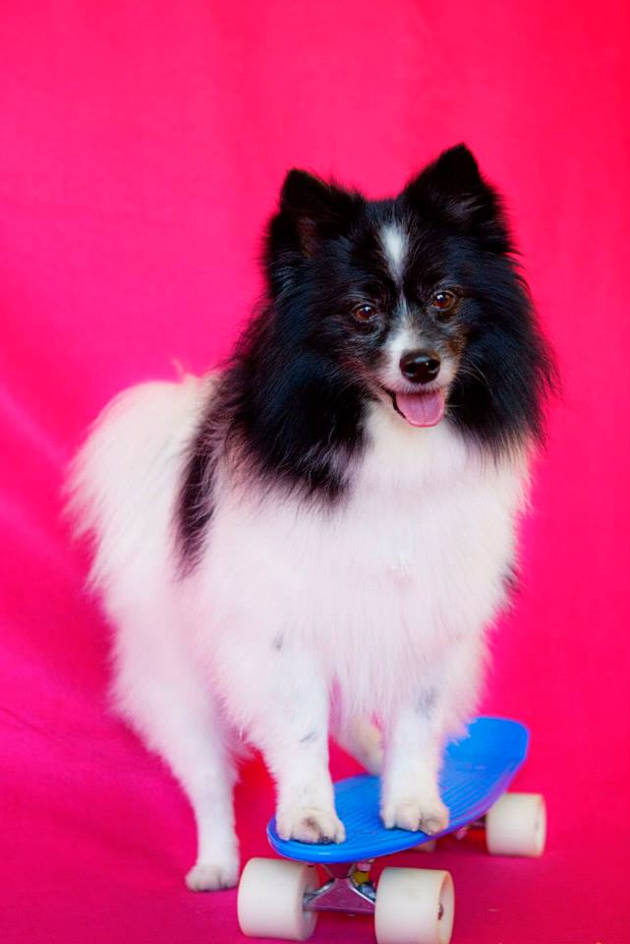
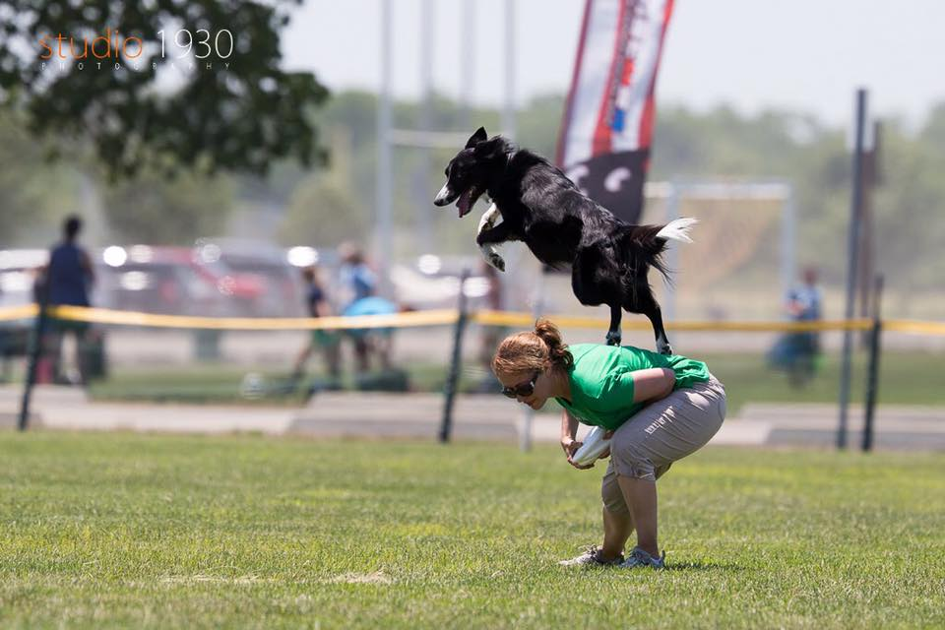
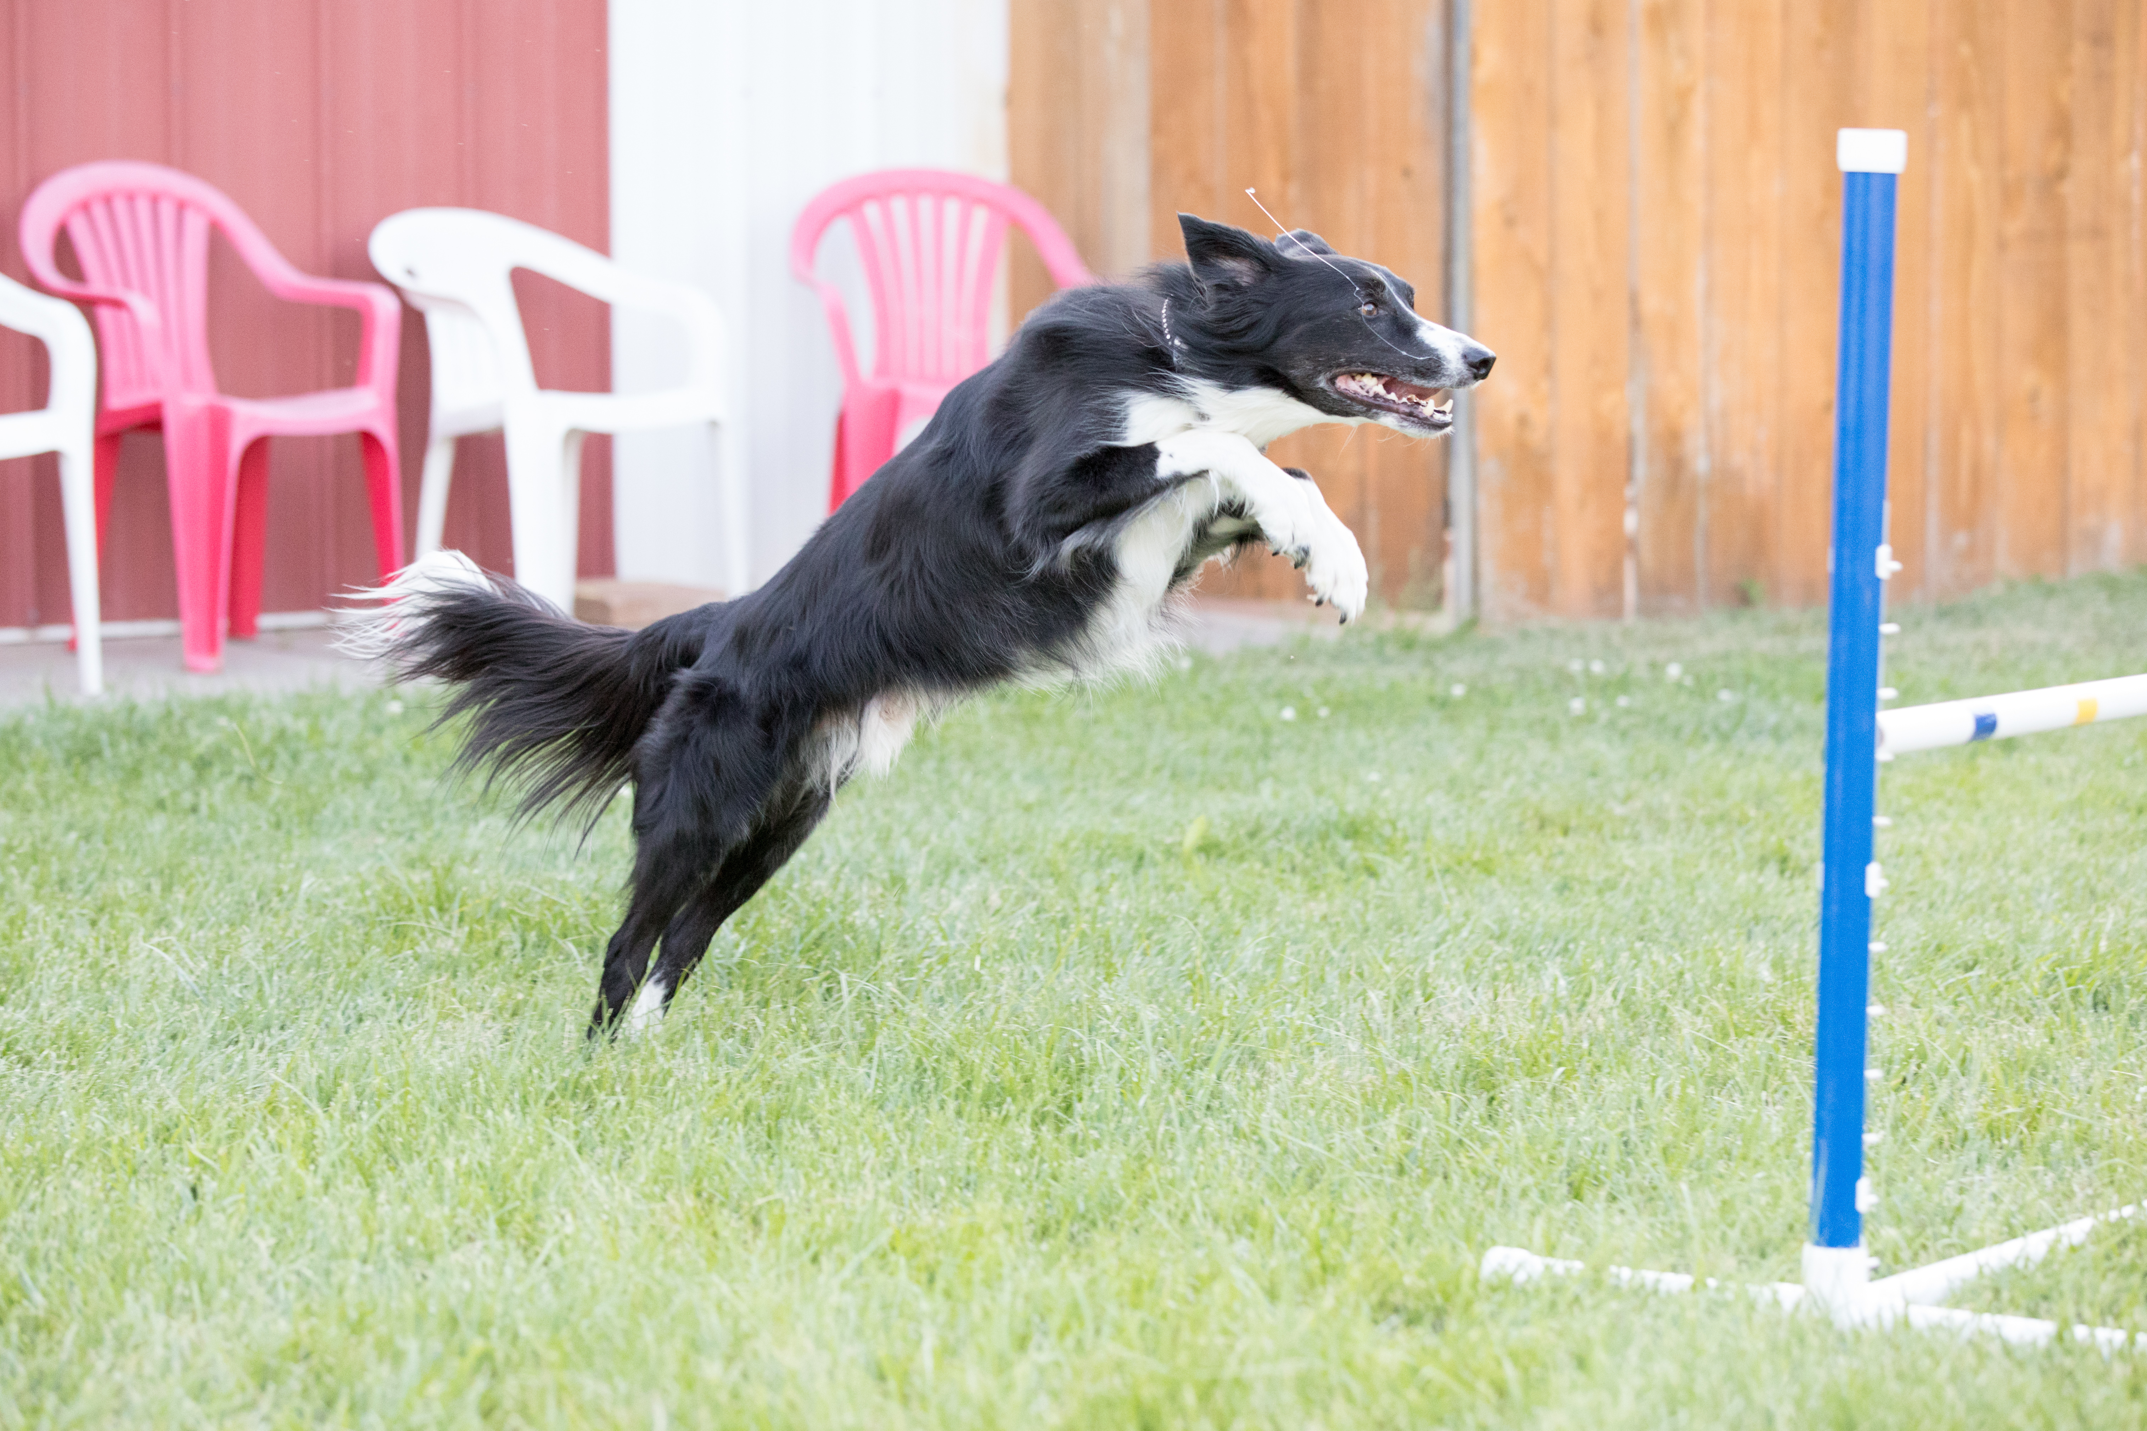
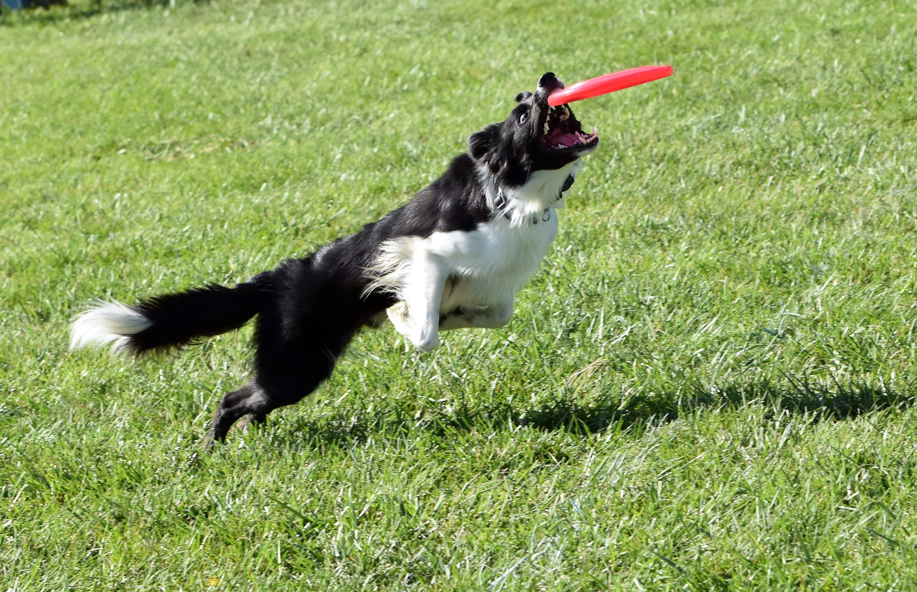
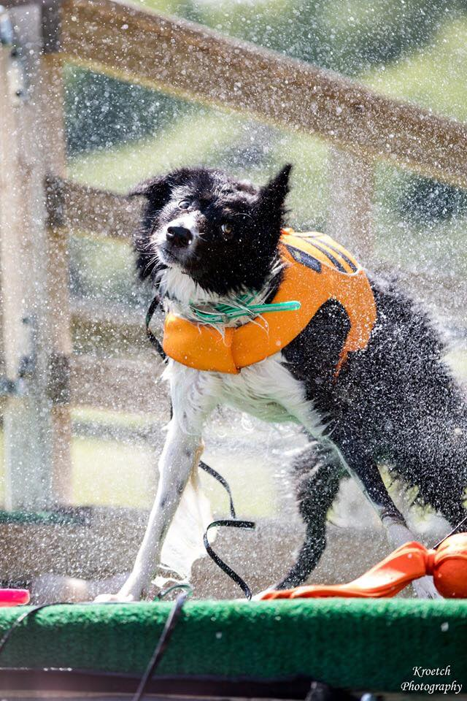
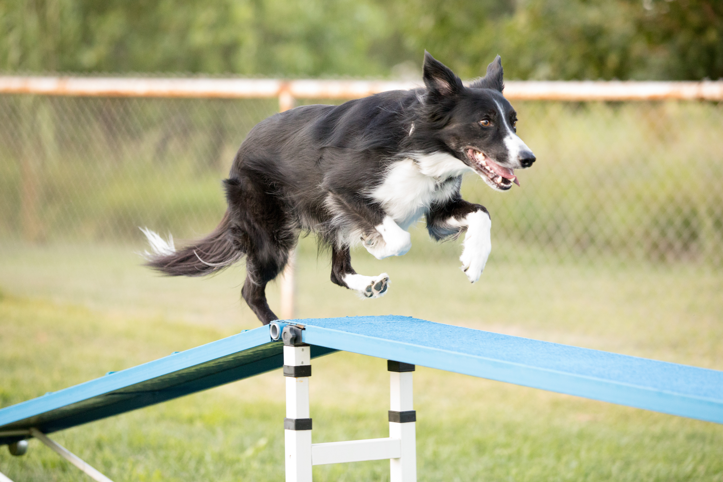
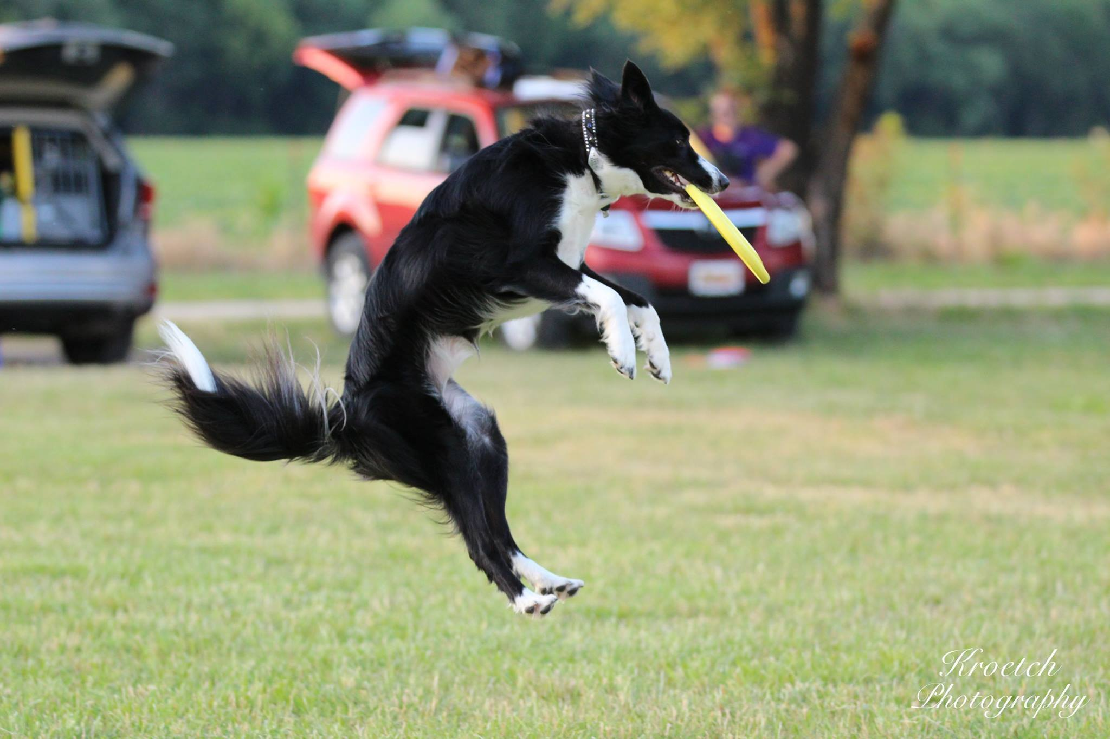
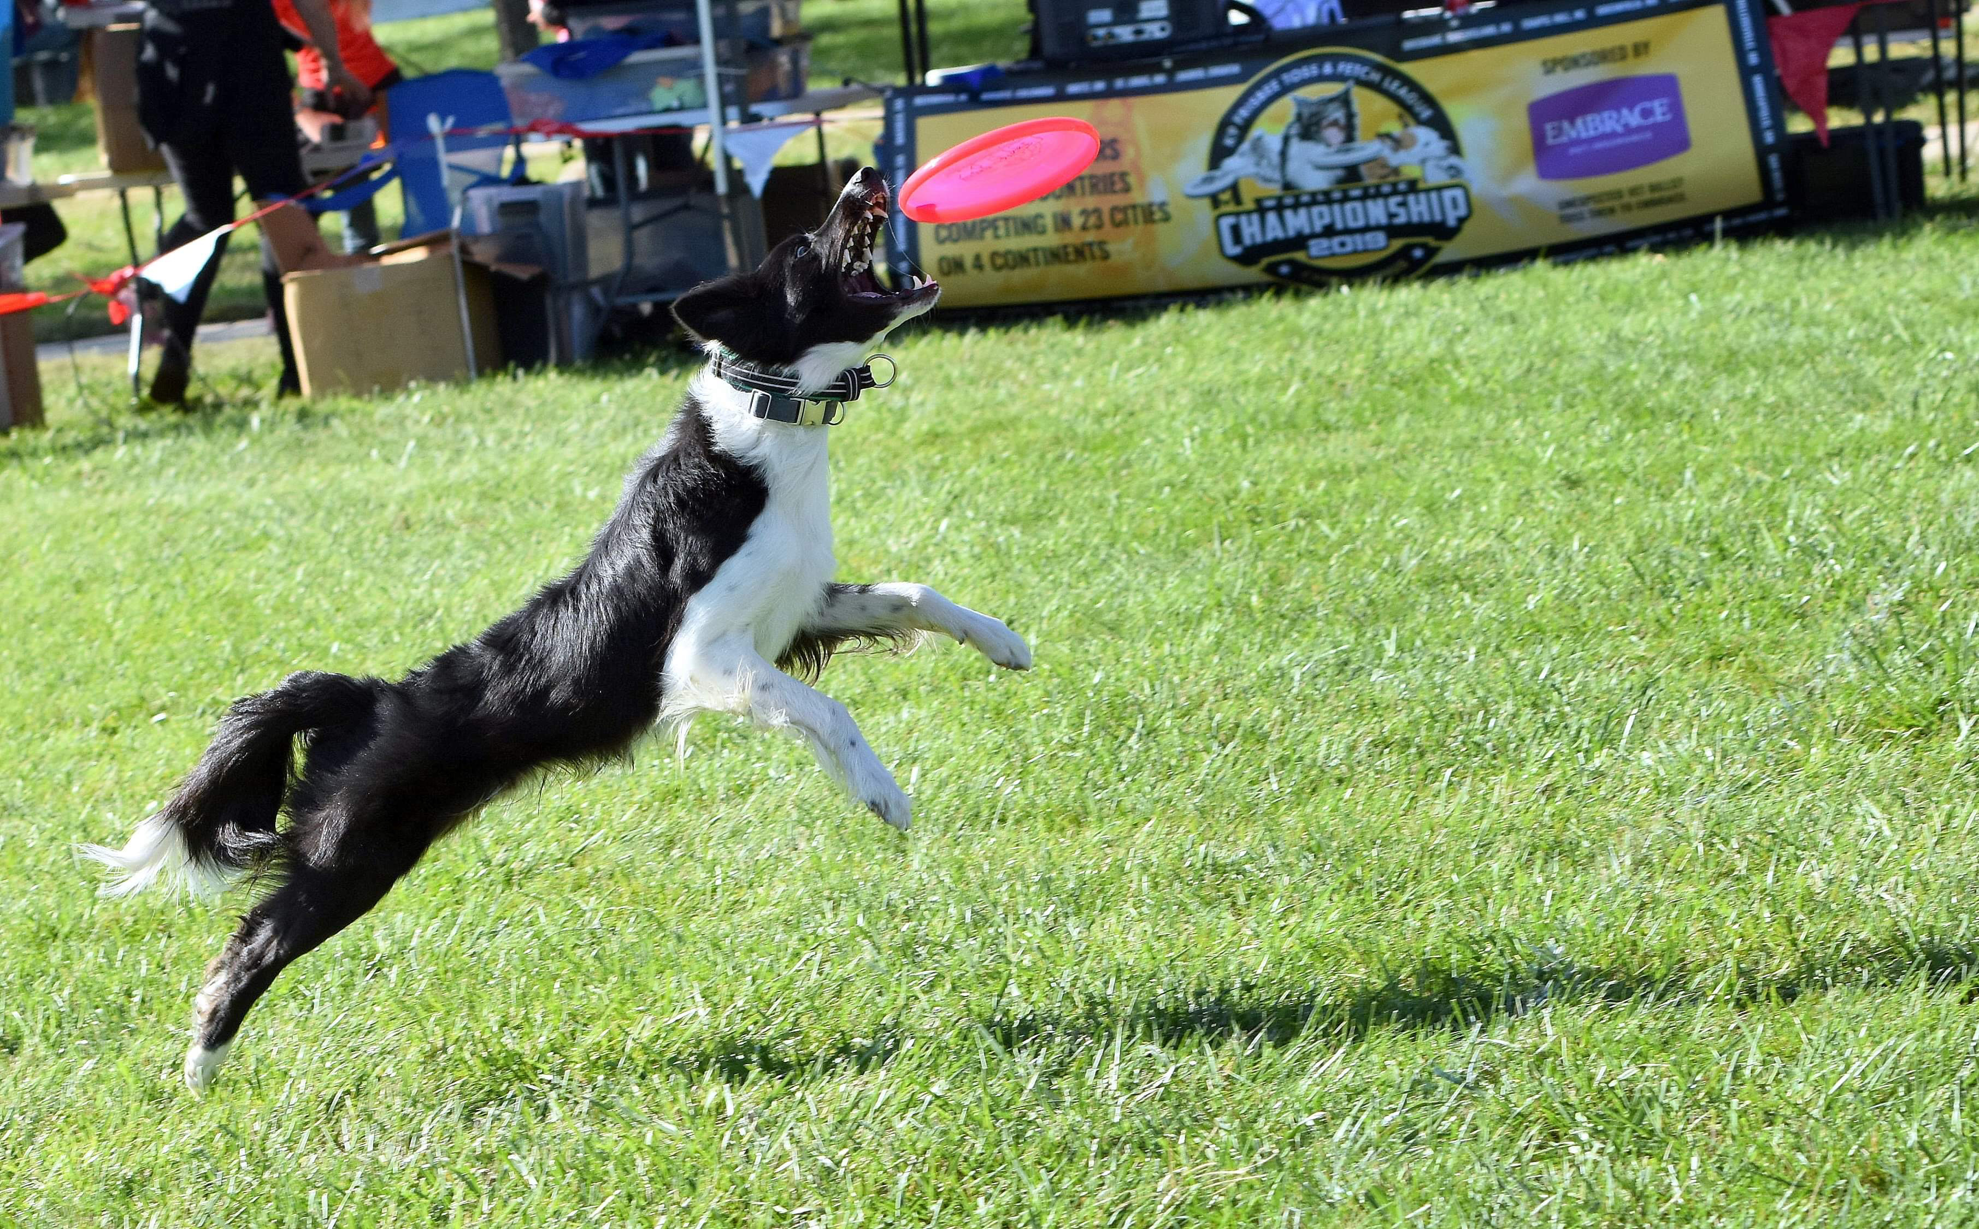
Dog Training
Kaya
Nickleby
Tonic

Slide 3
My Dog Aided My Homework

Slide 4
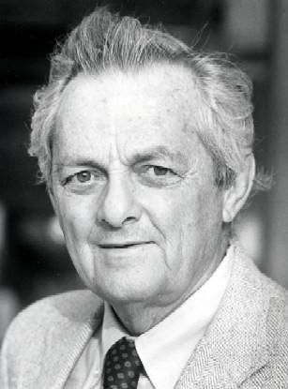
Frustration Theory
Abram Amsel
psychologist
Susan Garrett
world champion agility & dog trainer

Slide 5
What Causes Frustration?
Not receiving the expected or desired reward

Slide 6
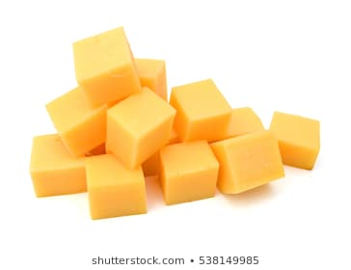
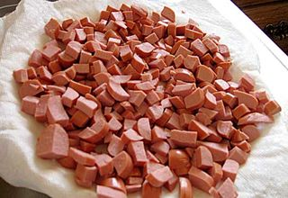
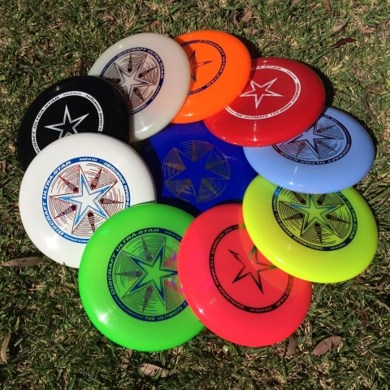
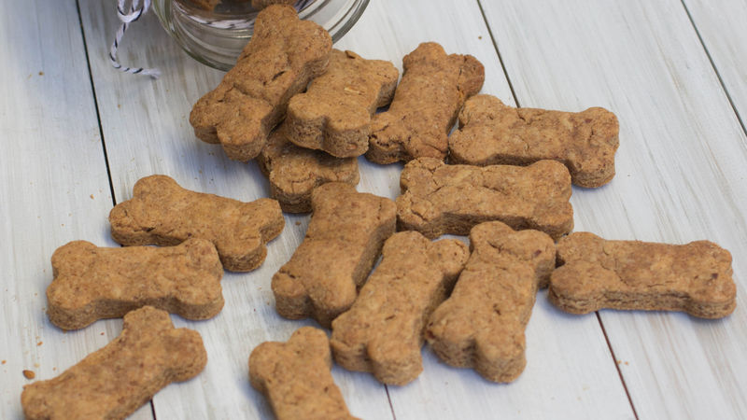
What Causes Frustration?
Not receiving the expected or desired reward

Slide 7
What Causes Frustration?
Not receiving the expected or desired reward

Slide 8
Four Responses to Frustration
Stress High
Stress Low /
Shut Down
Repeat Old Behaviors
Persist

Slide 9
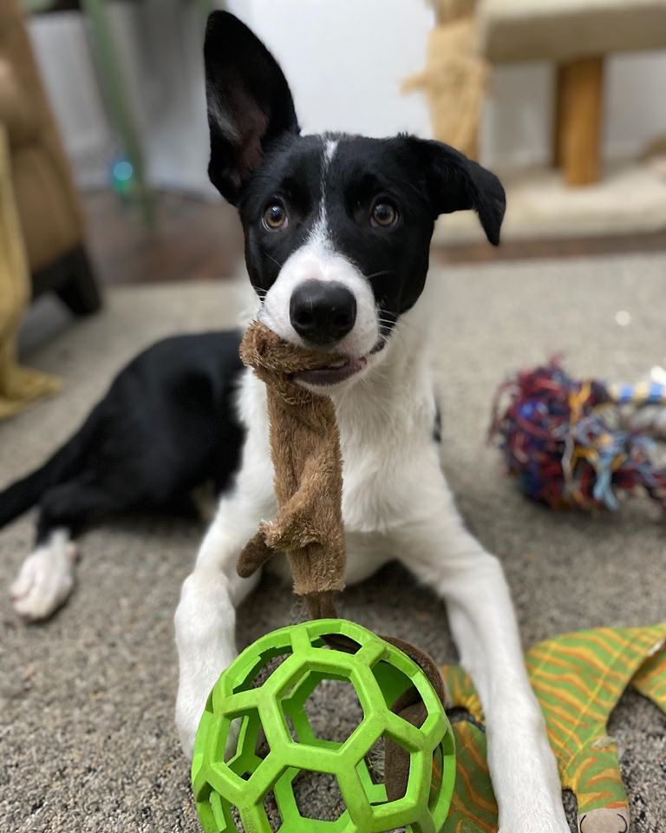
A frustration demonstration by puppy Wish

Slide 10
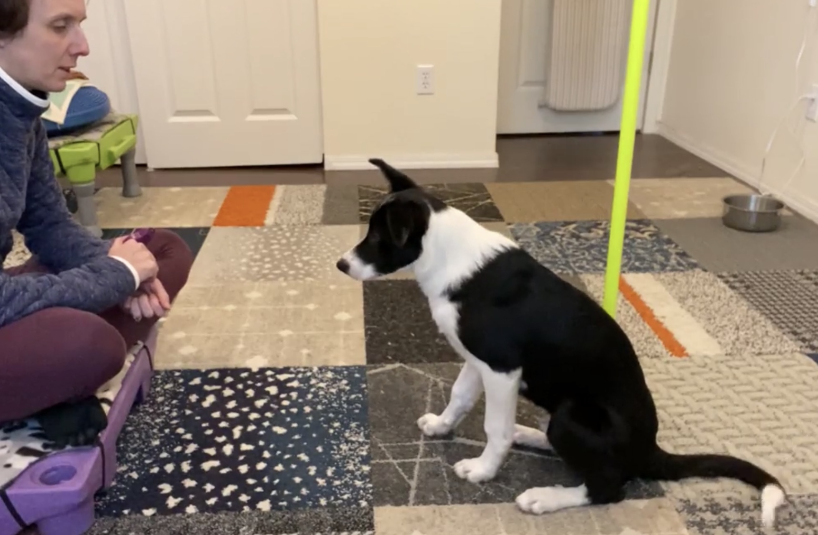

Slide 11
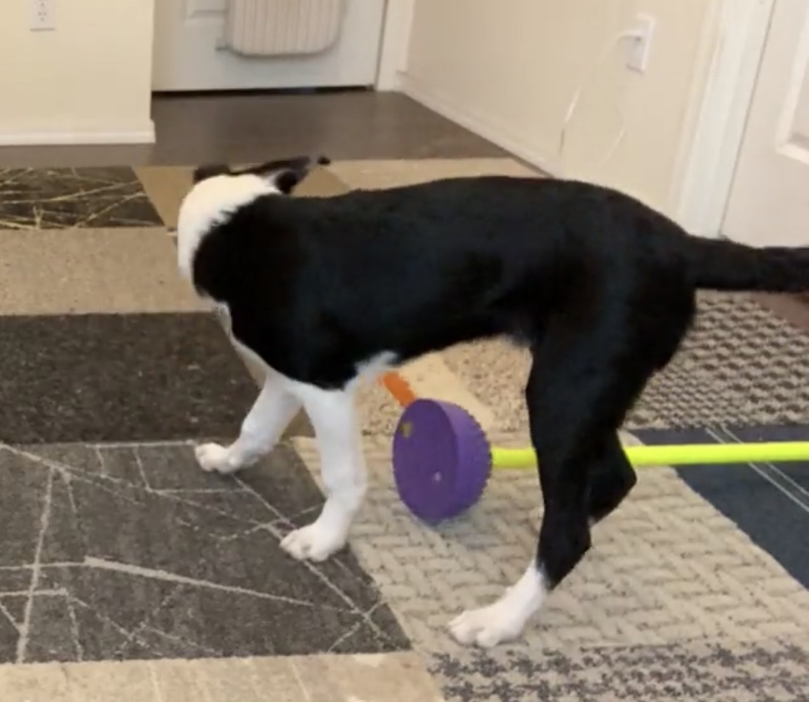
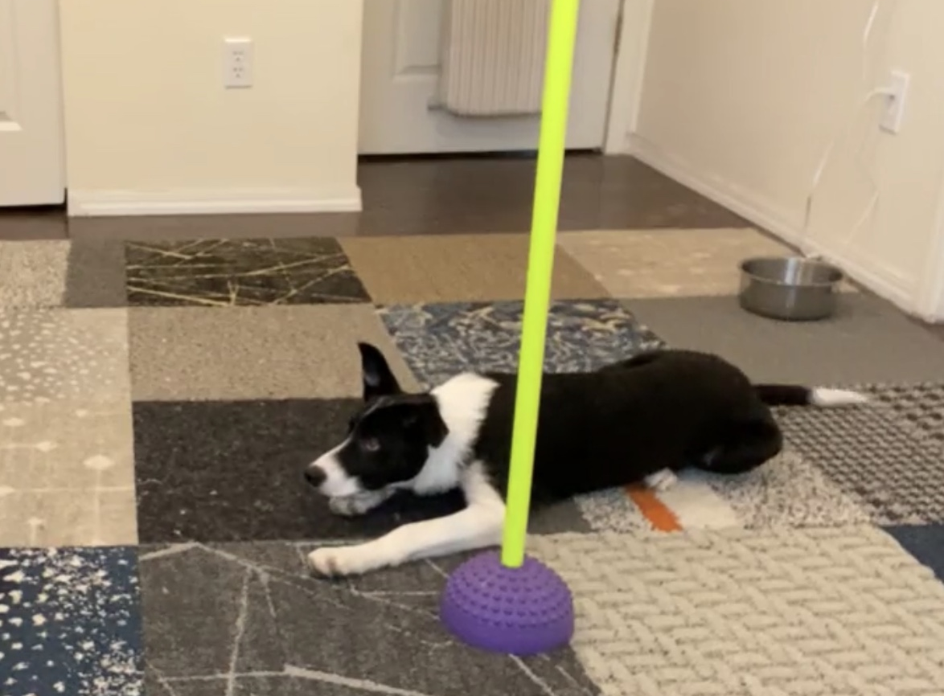

Slide 12
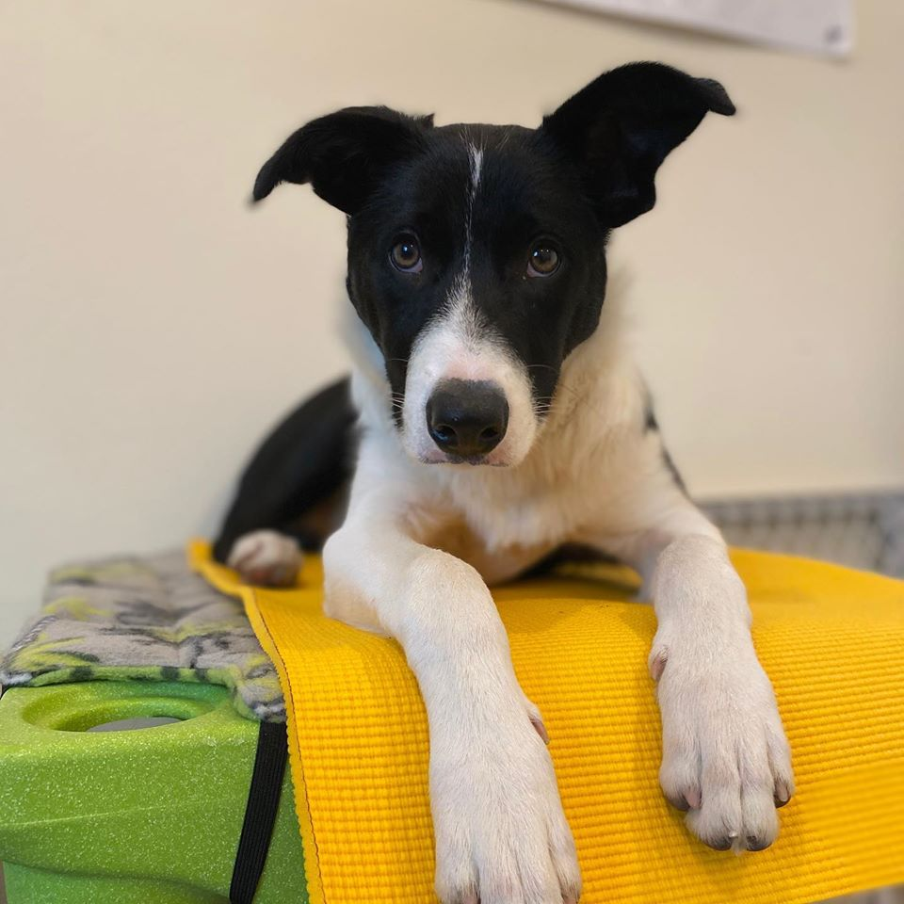

Slide 13
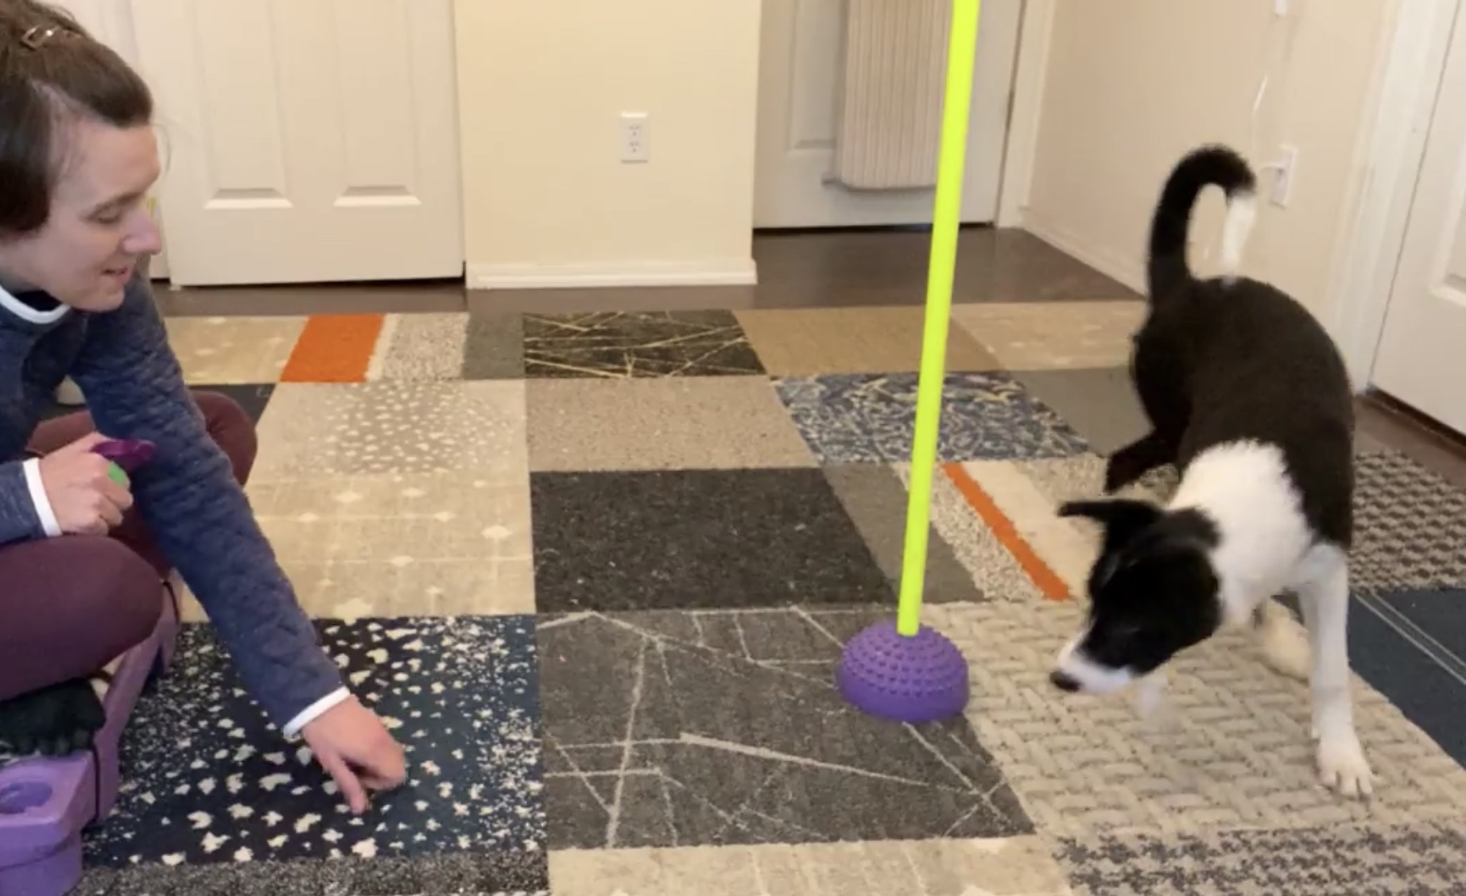

Slide 14
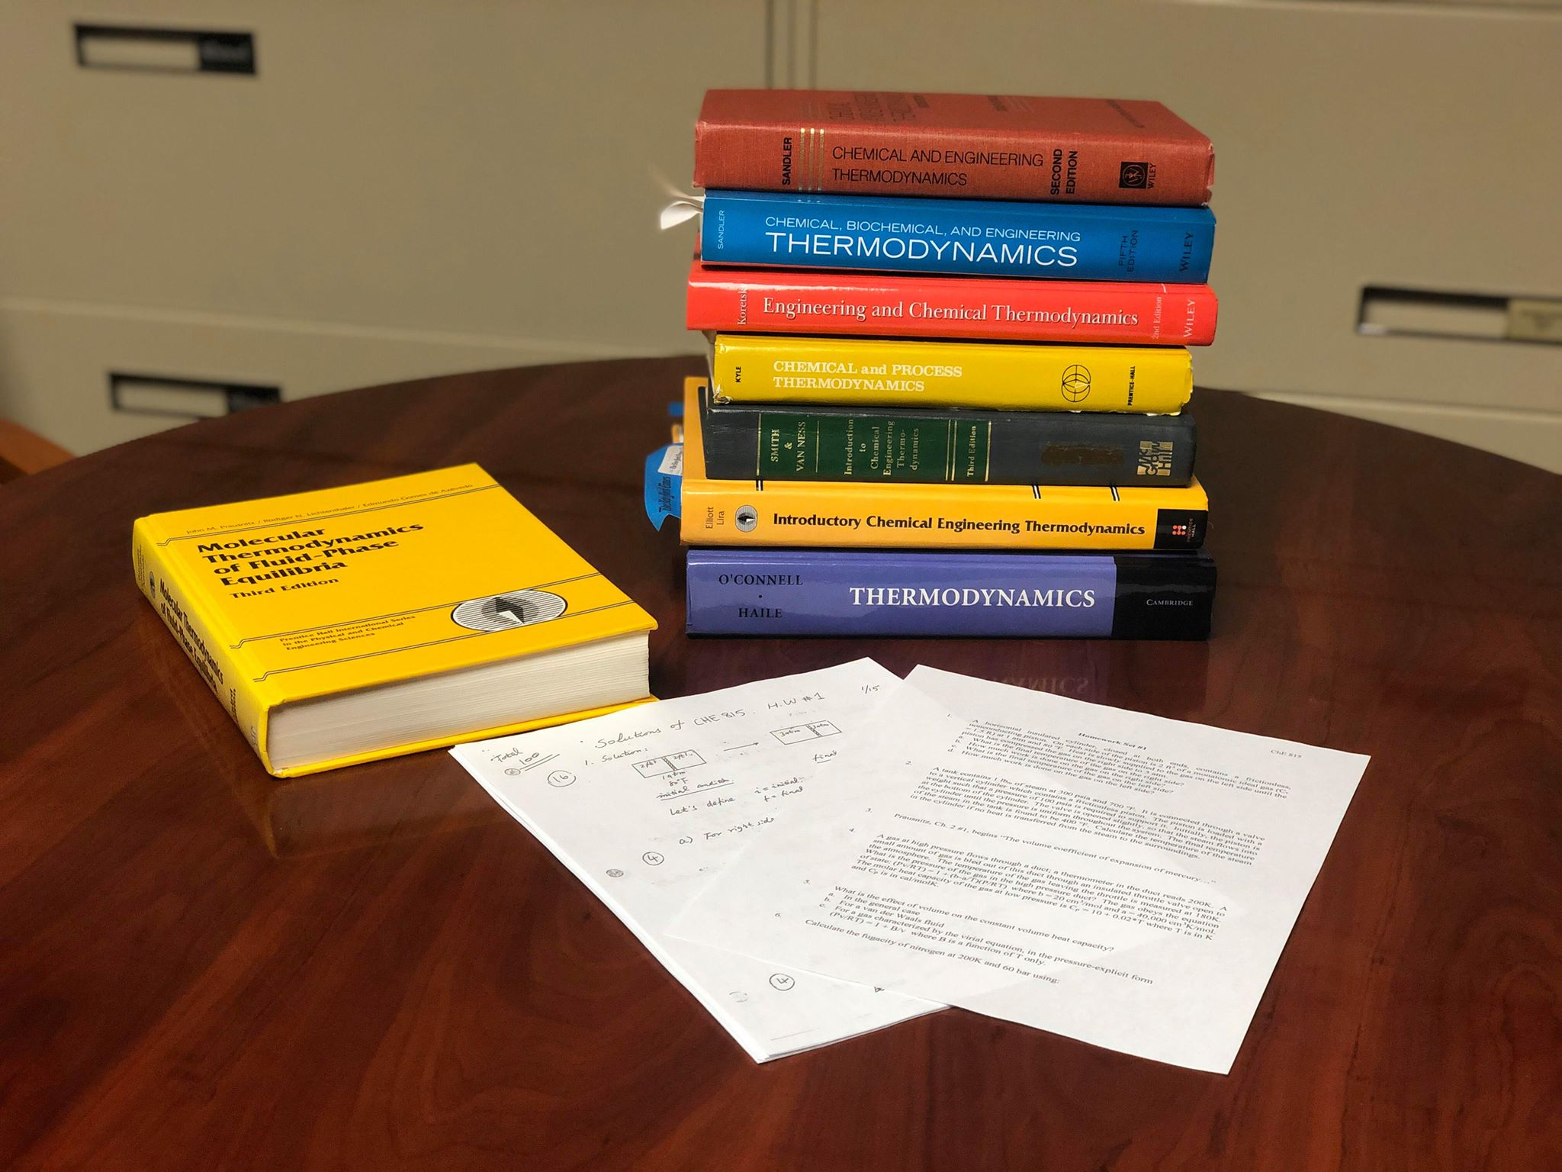
The Homework
Advanced Thermodynamics
First Year Graduate Students
First Assignment
Covers ALL of undergraduate thermodynamics
Challenging!

Slide 15
The Traditional Assignment
Assign
Homework
Students try
to get right answer
Final grade
See where they were wrong

Slide 16
Reframe the Assignment
Assign
Homework
Students try
to get right answer
Final grade
See where they were wrong
Assign
Homework
Students seek the problems they can’t solve
Solve hard problems together
Final grade

Slide 17
The Questions to Ask
What is the goal?
Where is the reward/reinforcer?
What is the reinforcement rate/success rate?
What changes might increase the success rate?

