Slide 1
Spotlight K-State 2020: Failing Isaiah: A requiem on attrition
Dr. Bryan Samuel, CCPD/AP
Chief Diversity and Inclusion Officer

Slide 2
MIAMI UNIVERSITY Oxford, OH | Est. 1809
https://i.pinimg.com/originals/f2/10/2b/f2102bb3171dbe571e96bc290832aa73.jpg

Slide 3
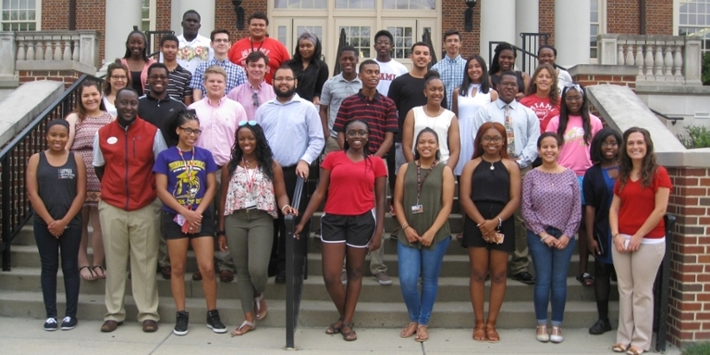
I Am Miami campaign

Slide 4
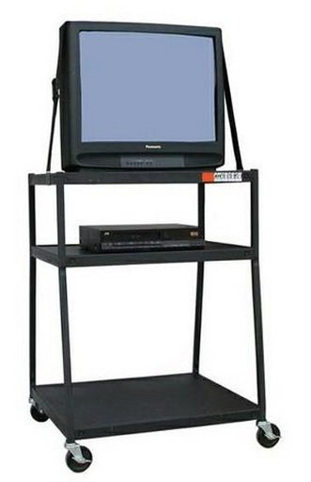
TV Cart
https://external-preview.redd.it/x-of9_SBwBmUHIdM2JAh-9rI0fhm-sJ1IaMLoIuI6iM.jpg?auto=webp&s=a3d79f19dcfa81ceb4bfcd86247acd8533a6a326

Slide 5
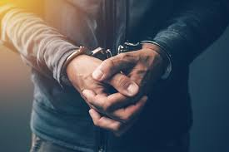
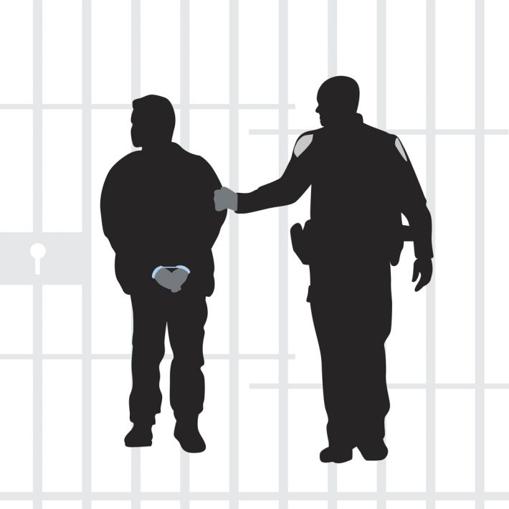
Incarceration – Permanent Record
https://s3-ap-southeast-2.amazonaws.com/elemento-ap-southeast-2-media-prod/websterslawyers/wp-content/uploads/media/2017/06/Silhouette-of-arrested-man-iStock-611901764-710x710-1.jpg

Slide 6
The University Failed the Student
https://www.thoughtco.com/thmb/1ChzZK7vCa3Ob80ironcmbFPv6I=/768x0/filters:no_upscale():max_bytes(150000):strip_icc()/failing-report-card-520578906-589cbb9a5f9b58819c159cd1.jpg
https://about.canva.com/wp-content/uploads/sites/3/2017/05/Report-Card-Thumb.jpg

