Slide 1
COACH, HOW DO I Make a Masterpiece?

Slide 2
Parable of the Pots
Group A
Group B

Slide 3
Uninspired Running

Slide 4
OK, COACH, HOW MUCH PRACTICE BEFORE I MAKE A Masterpiece?

Slide 5
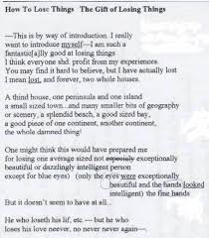
The genius is in the revision
Elizabeth Bishop’s brilliant poem
…whatever this was

Slide 6
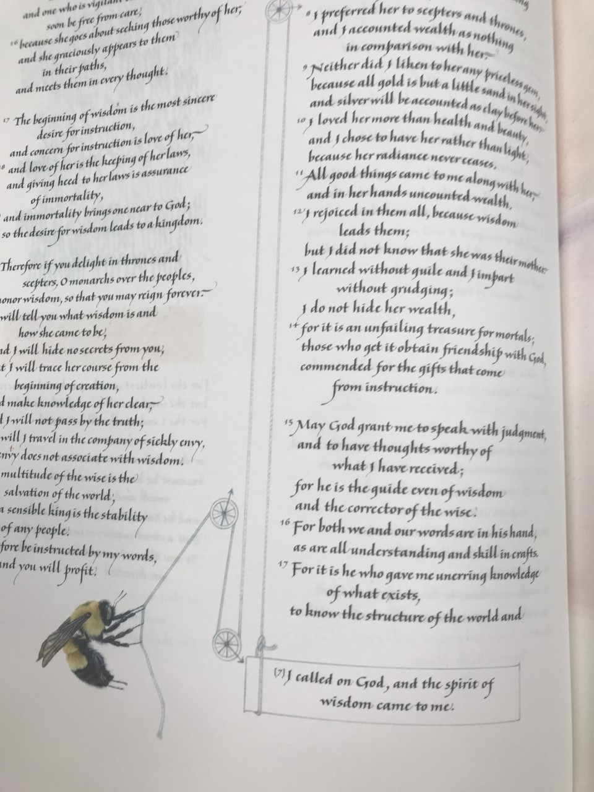
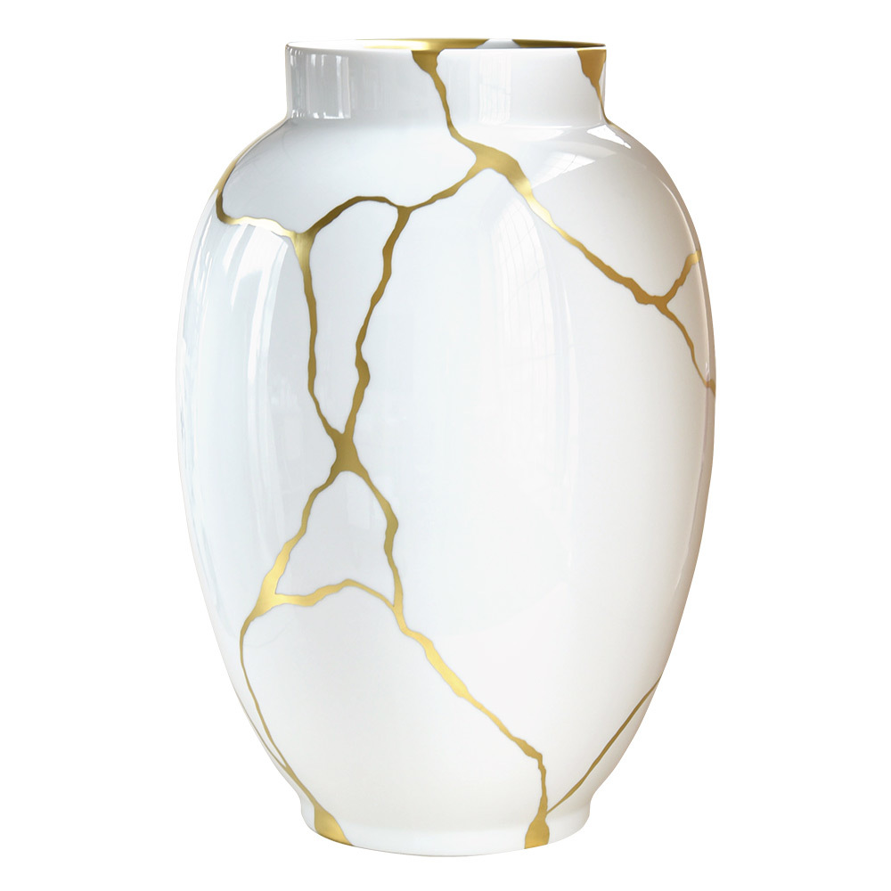
The Gift of Mistakes

Slide 7
But what if I DO MY BEST, AND IT’s STILL NOT A MASTERPIECE?!

Slide 8
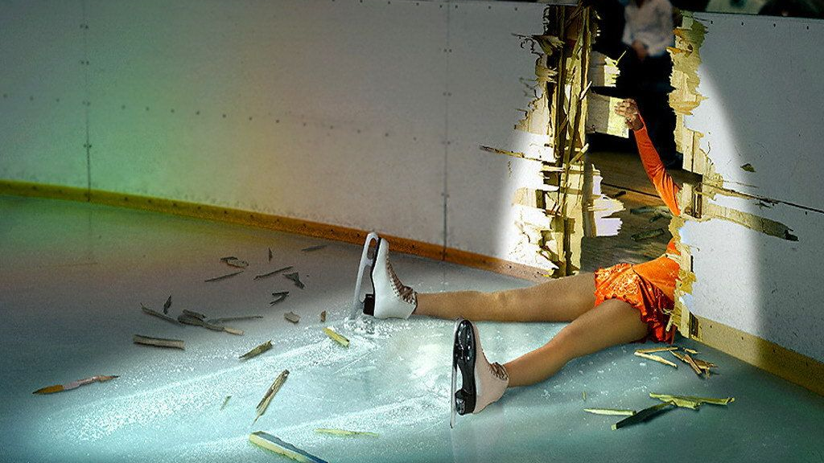
Assess Risk, not perfection
ATTEMPT THE TRIPLE AXLE!

Slide 9
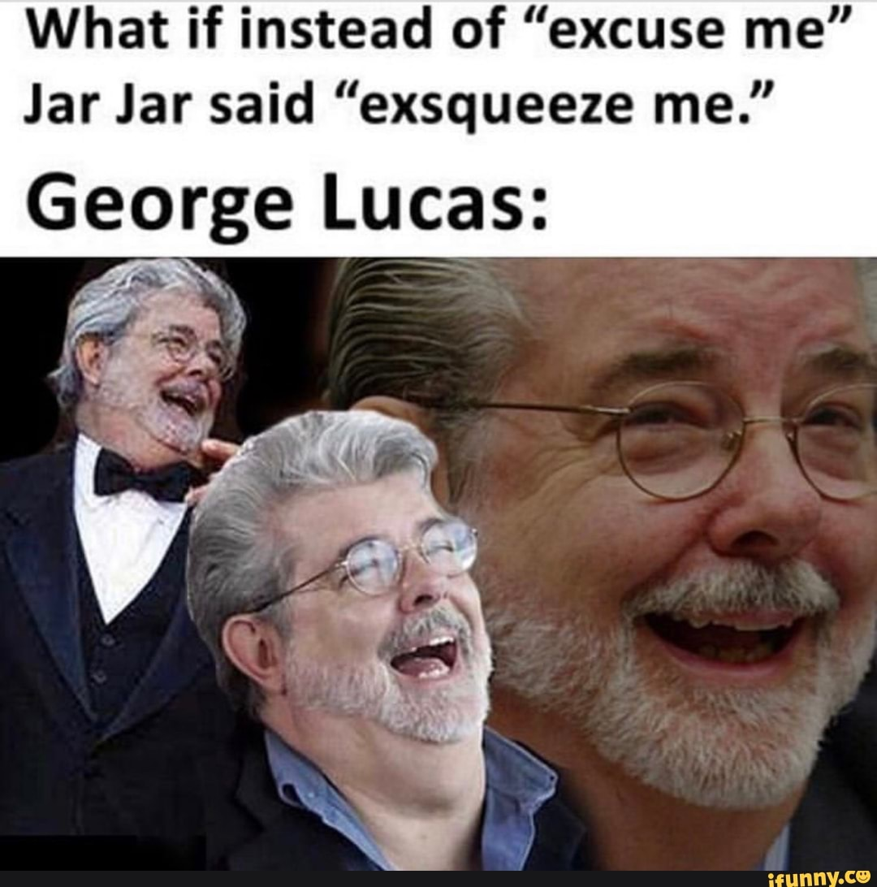
What can happen if you revise too much

Slide 10
So coach, how many mistakes Does It Take to make a masterpiece?
Final Draft of lovely Dutch seashore
Early draft with rotting whale carcass

